Slide 1
Introduction to Composite Materials Design—3rd Edition
Chapter 9
©2018 by Taylor & Francis Group LLC, all rights reserved. See the front matter of the textbook for copyright information. Do not post electronically outside of course delivery systems where access is strictly restricted to students enrolled in your course.

Slide 2
¼ of unit cell of a plain weave fabric

Slide 3
Plan weave and twill textiles

Slide 4
Satin and twill textiles

Slide 5
5/1/2 twill fabric

Slide 6
Twill 4/1/1, 4/1/2, 4/1/2 side view

Slide 7
Full unit cell of plain weave

Slide 8
¼ RUC of plain weave

Slide 9
Photomicrograph showing undulation of fill and cross section of warp (weft)

Slide 10
Tow coordinate system 1,2,3 and RVE c.s. x,y,z

Slide 11
Extreme types of fabric stacking

Slide 12
Asymmetric stacking

Slide 13
Stress redistribution

Slide 14
Load redistribution

Slide 15
Textile-reinforced composite response

Slide 16
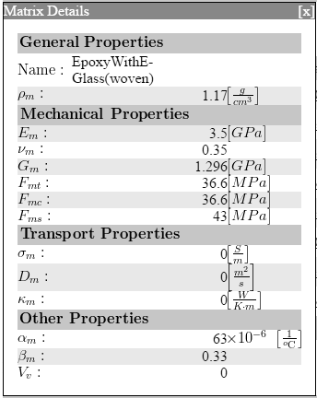
Example 9.1: properties

Slide 17
Example 9.1: geometry

Slide 18
Example 9.1: results

Slide 19
¼ RUC with gap

Slide 20
Predictions

Slide 21
Predictions

Slide 22
Twill 5/1/1

Slide 23
Twill 5/1/2

Slide 24
Satin 5/2/1

