Slide 1
Introduction to Composite Materials Design—3rd Edition
Chapter 8
©2018 by Taylor & Francis Group LLC, all rights reserved. See the front matter of the textbook for copyright information. Do not post electronically outside of course delivery systems where access is strictly restricted to students enrolled in your course.

Slide 2
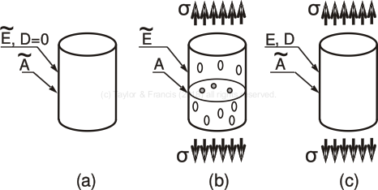
Unstressed, stressed, and effective material

Slide 3
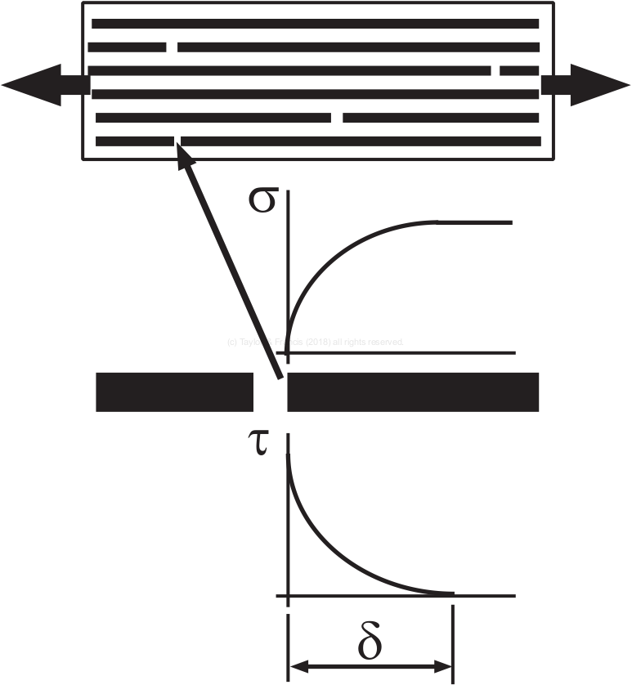
Shear lag

Slide 4
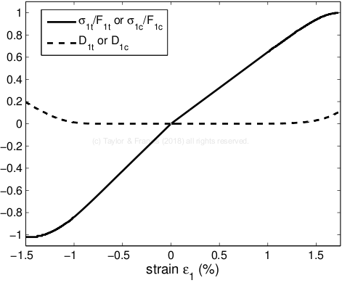
Longitudinal stress and damage

Slide 5
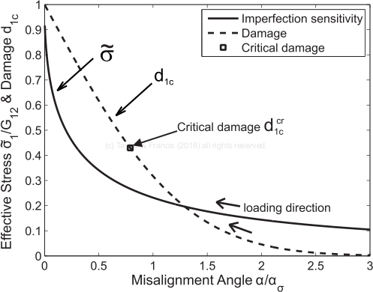
Imperfection sensitivity due to misalignment

Slide 6
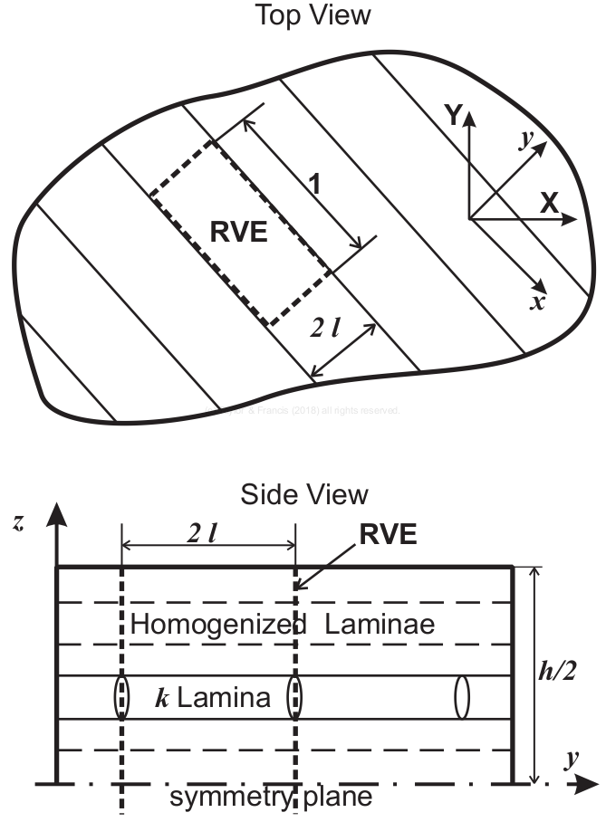
Representative volume element

