Slide 1
Introduction to Composite Materials Design—3rd Edition
Chapter 7
©2018 by Taylor & Francis Group LLC, all rights reserved. See the front matter of the textbook for copyright information. Do not post electronically outside of course delivery systems where access is strictly restricted to students enrolled in your course.

Slide 2
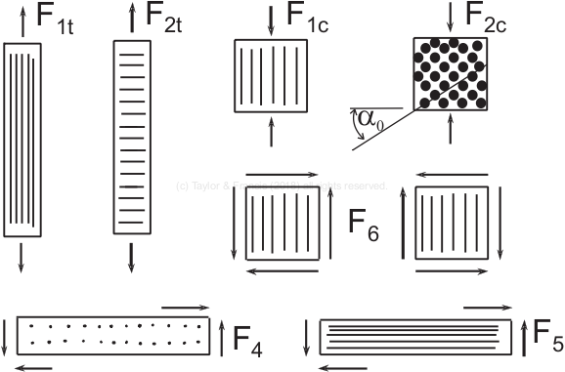
Strength values and how they are measured

Slide 3
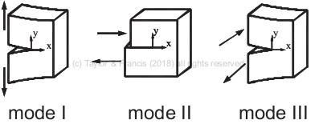
Modes of fracture

Slide 4
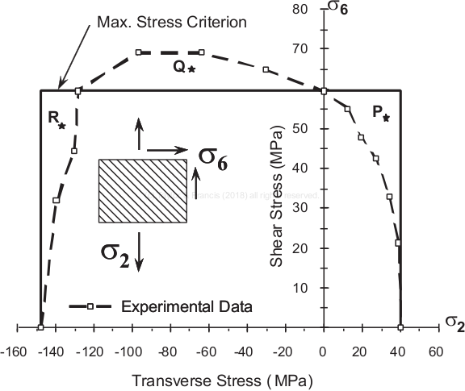
Maximum stress criterion in stress space

Slide 5
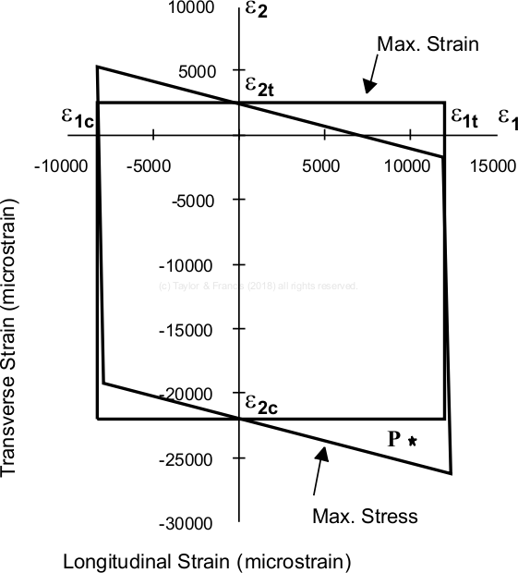
Maximum strain and stress criteria in strain space

Slide 6
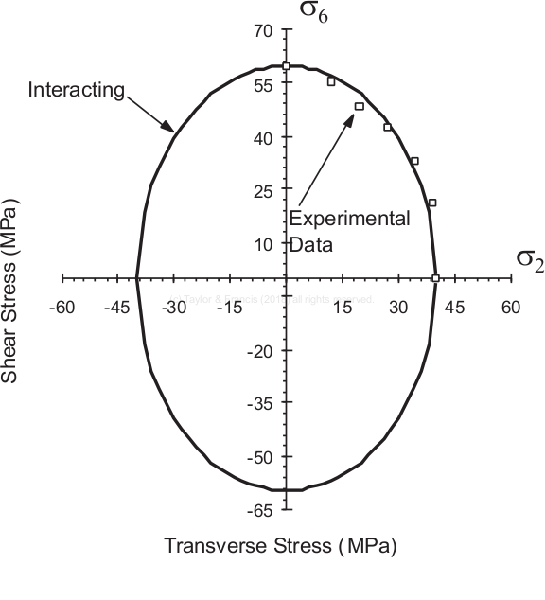
Interacting failure criterion

Slide 7
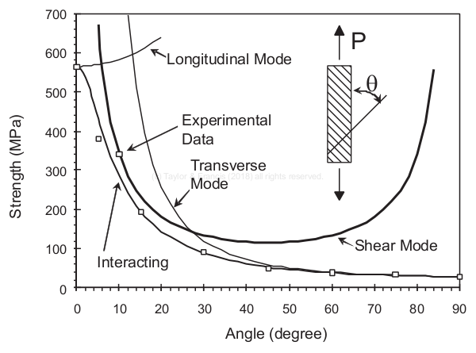
Off-axis test

Slide 8
Cracks at +/- 70 degrees in a laminate

Slide 9
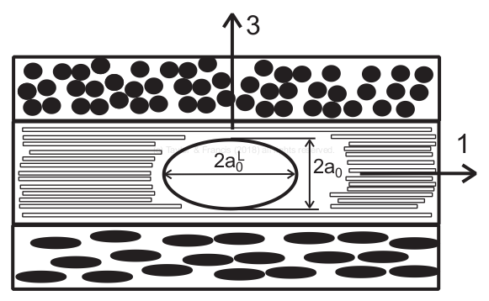
Representative crack

Slide 10
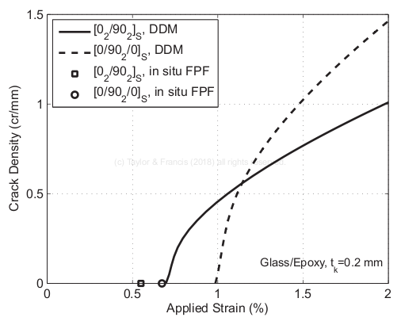
Prediction of crack density vs. applied strain

Slide 11
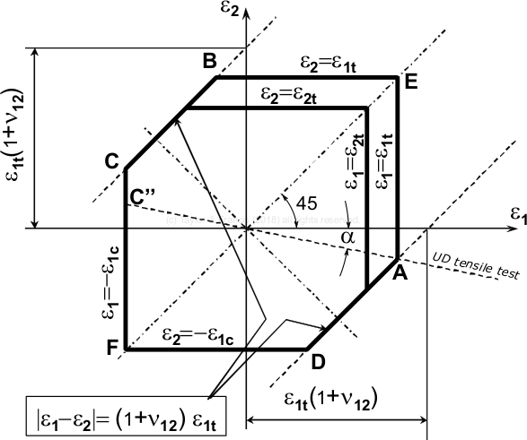
Truncated maximum strain criterion

Slide 12
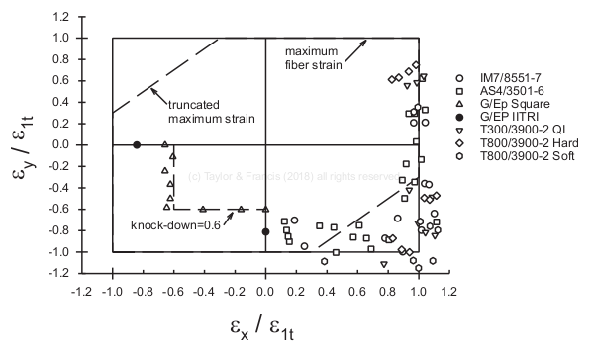
Comparison TMS with experimental data

Slide 13
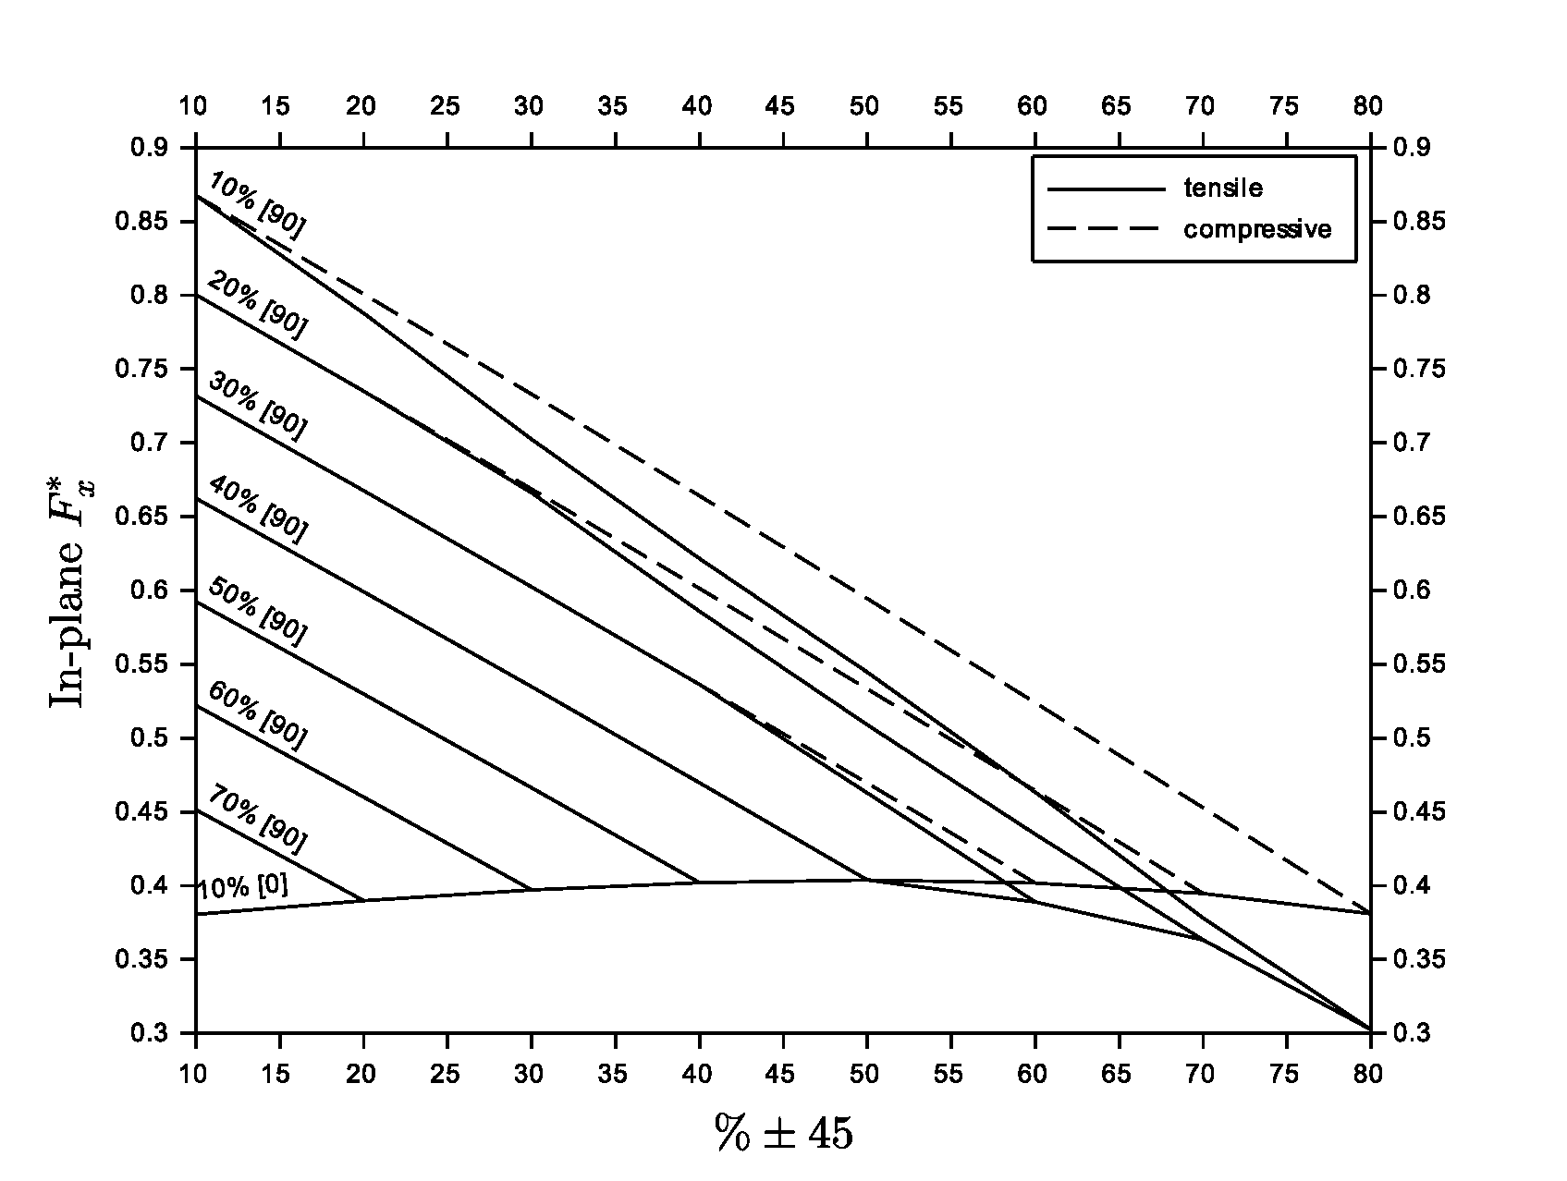
Universal carpet plot of strength Fx, Glass/Epoxy

Slide 14
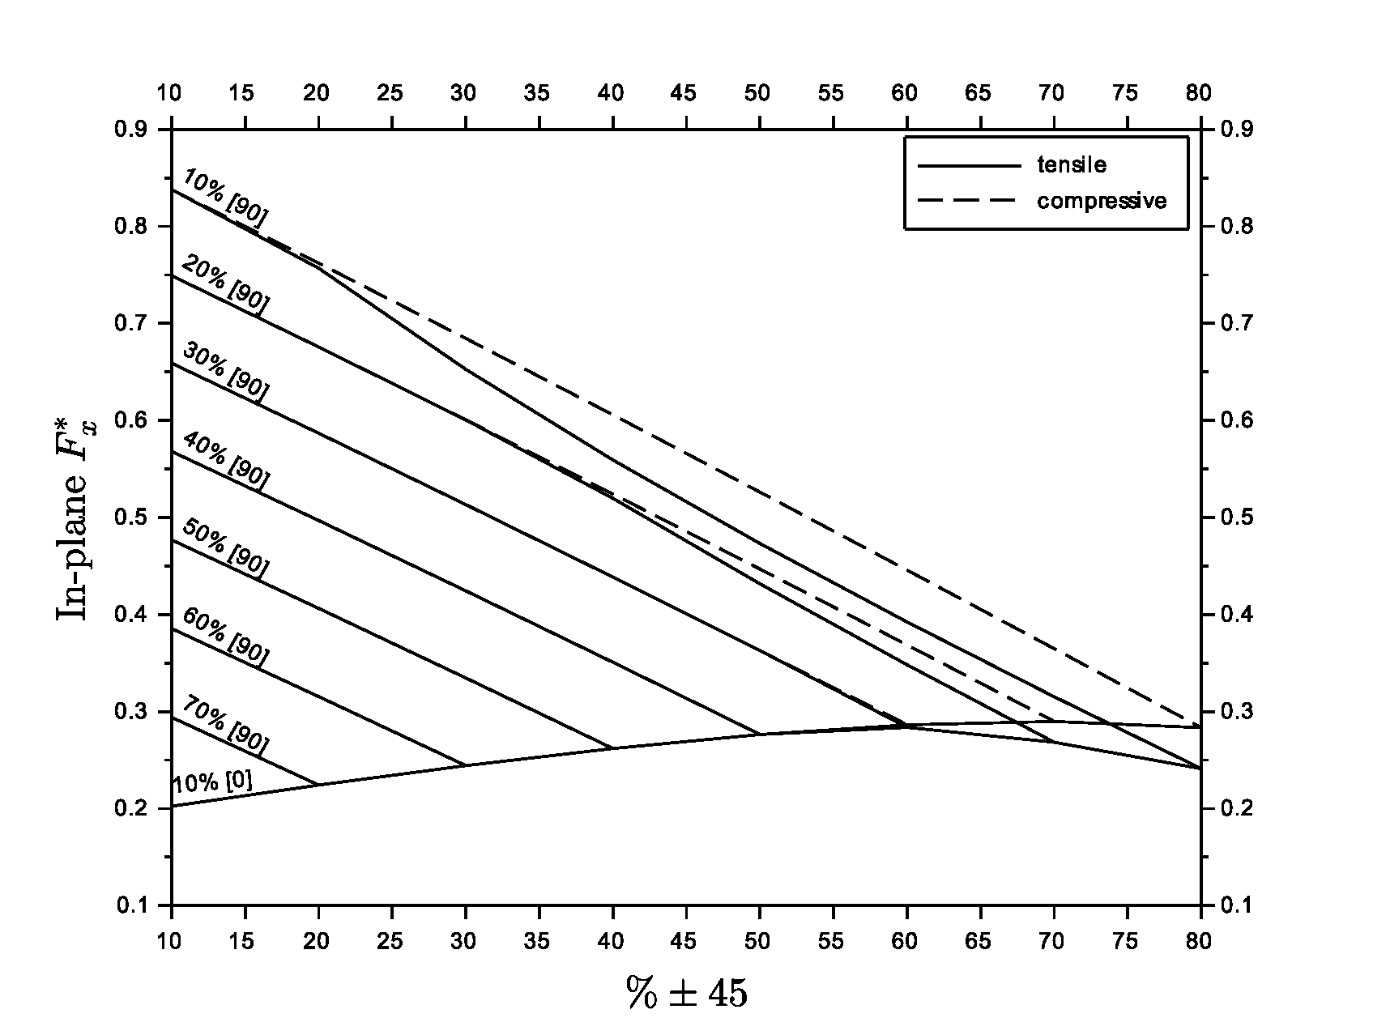
Universal carpet plot of strength Fx, Carbon Epoxy

Slide 15
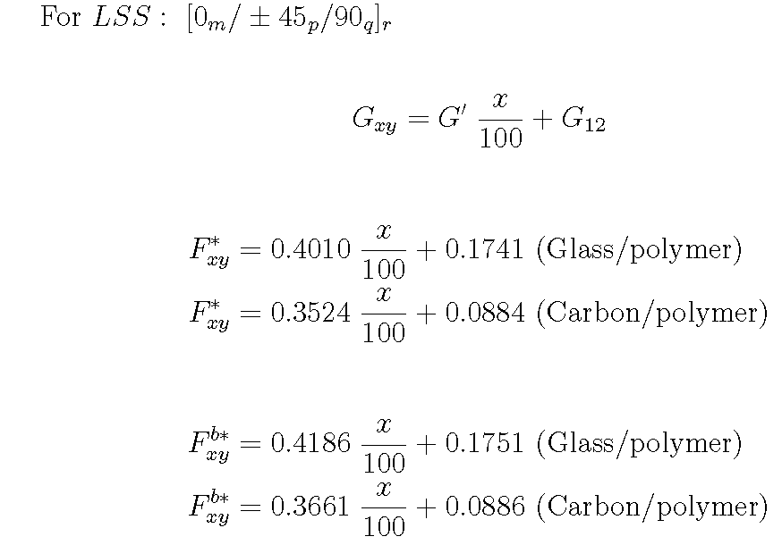
Universal shear properties

Slide 16
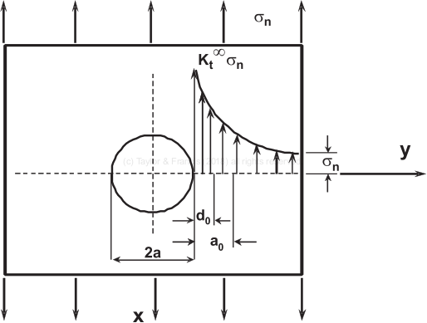
Stress concentration

Slide 17
Stress concentration

Slide 18
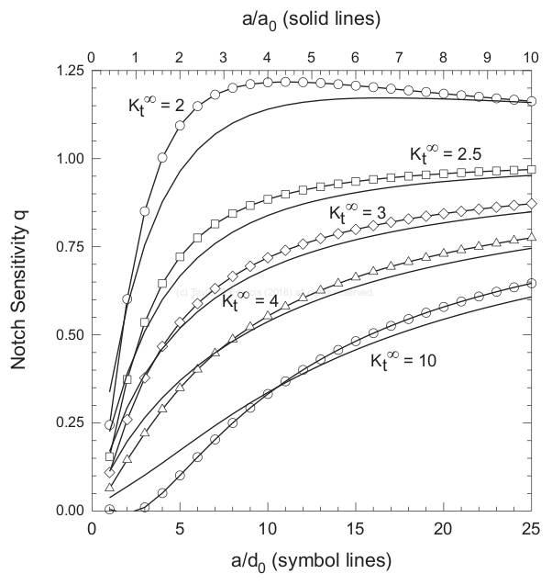
Notch sensitivity

Slide 19
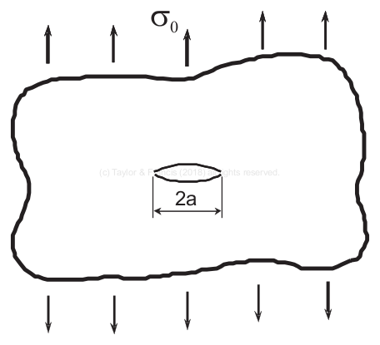
Crack in an infinite plate

