Slide 1
Introduction to Composite Materials Design—3rd Edition
Chapter 6
©2018 by Taylor & Francis Group LLC, all rights reserved. See the front matter of the textbook for copyright information. Do not post electronically outside of course delivery systems where access is strictly restricted to students enrolled in your course.

Slide 2
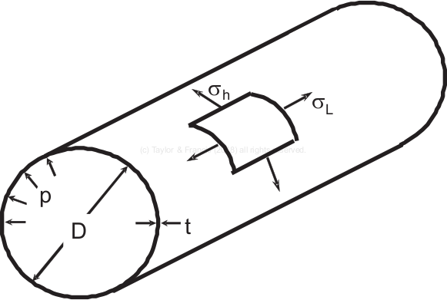
Cylindrical pressure vessel

Slide 3
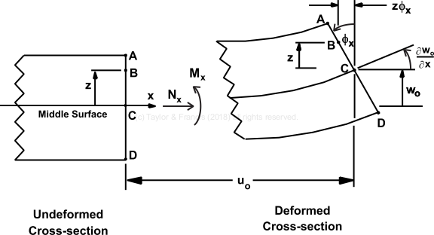
Plate deformation

Slide 4
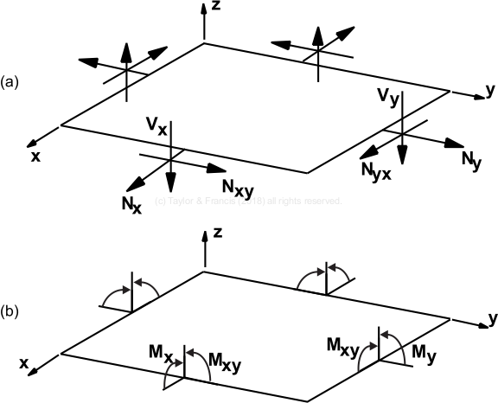
Stress resultants

Slide 5
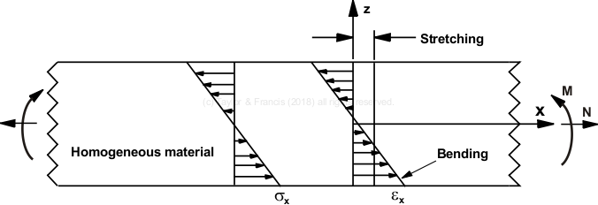
Stress and strain in homogeneous plate

Slide 6
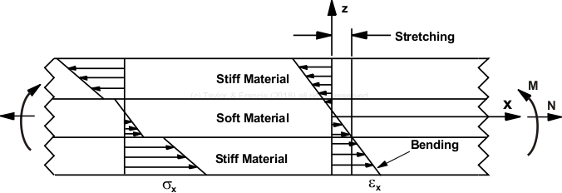
Stress and strain in laminated plate

Slide 7
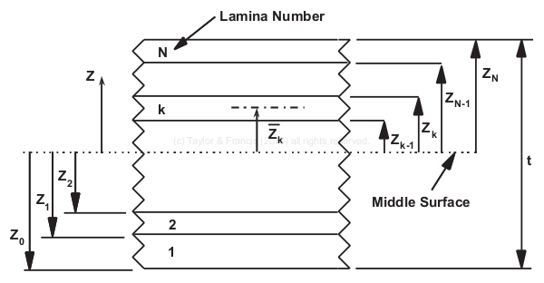
Notation used to describe a laminate

Slide 8
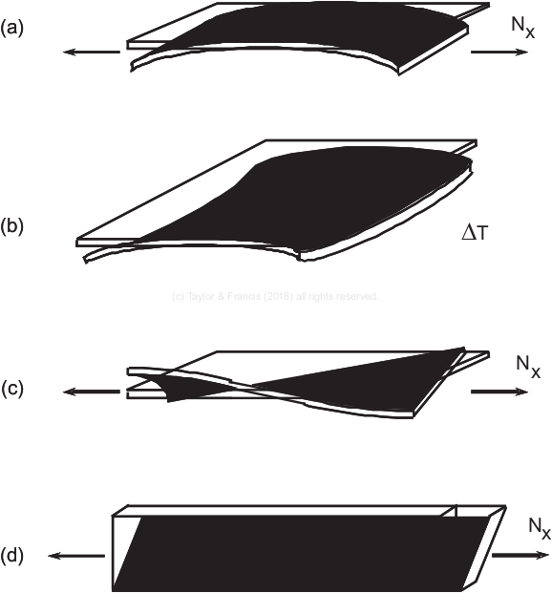
Coupling effects

Slide 9
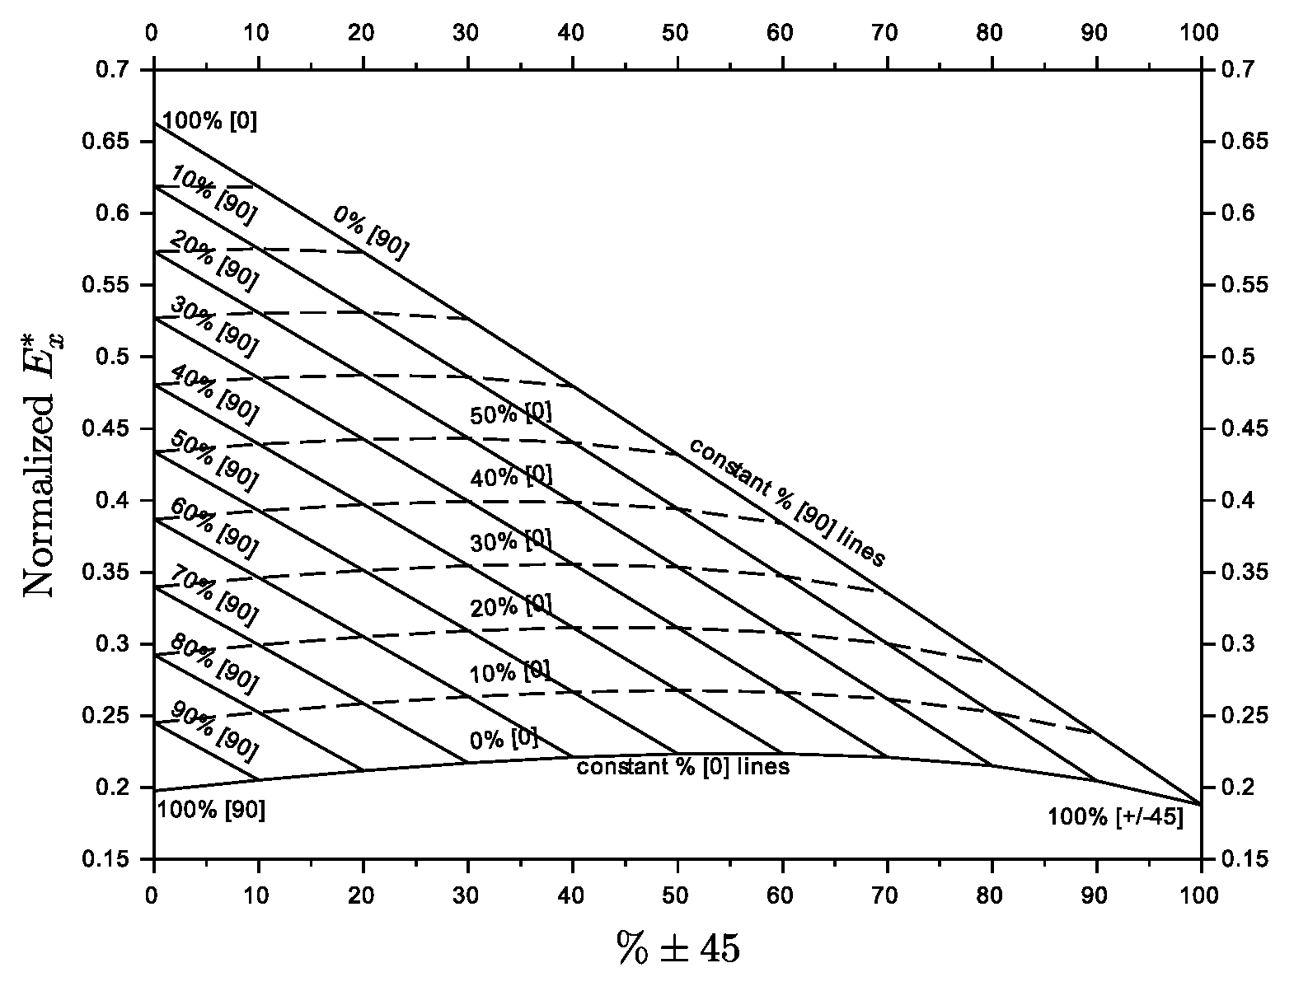
Universal carpet plot modulus Ex Glass/Epoxy

Slide 10
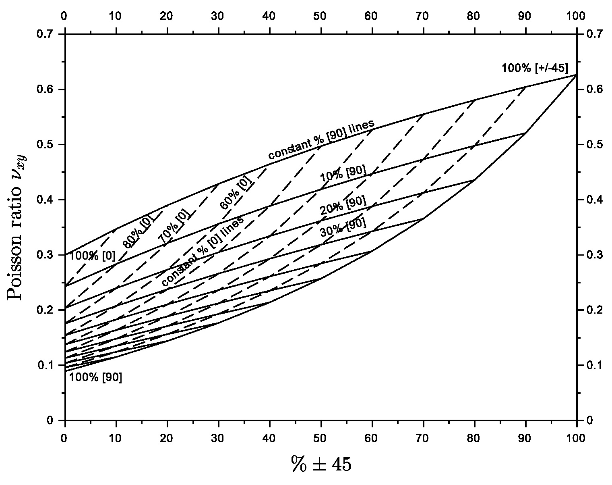
Universal carpet plot v_{xy} E-Glass/Epoxy

Slide 11
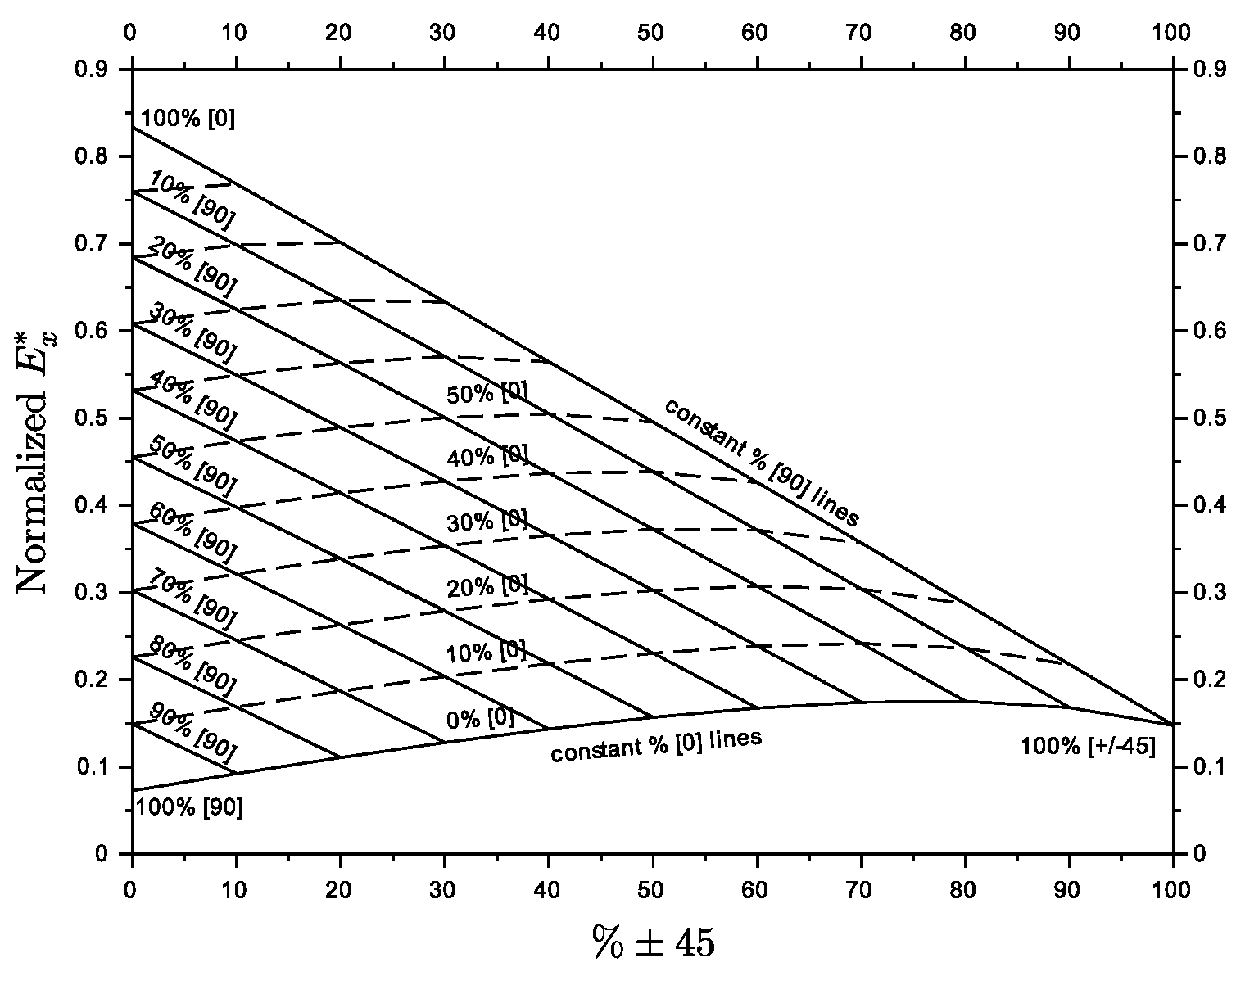
Universal carpet plot Ex Carbon/Epoxy

Slide 12
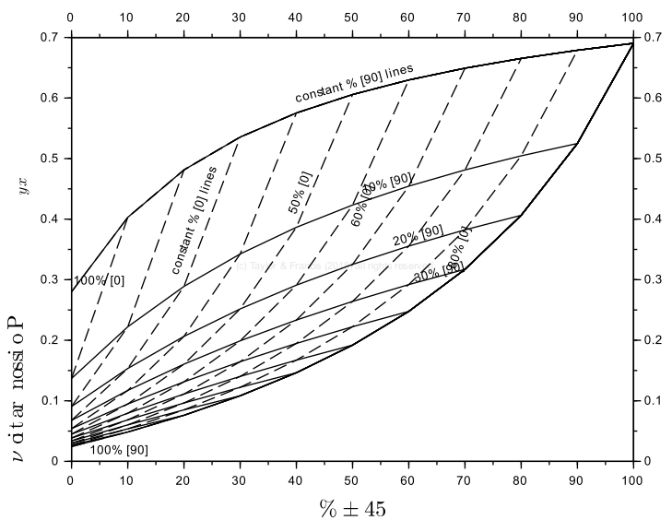
Universal carpet plot v_{xy} Carbon/Epoxy

Slide 13
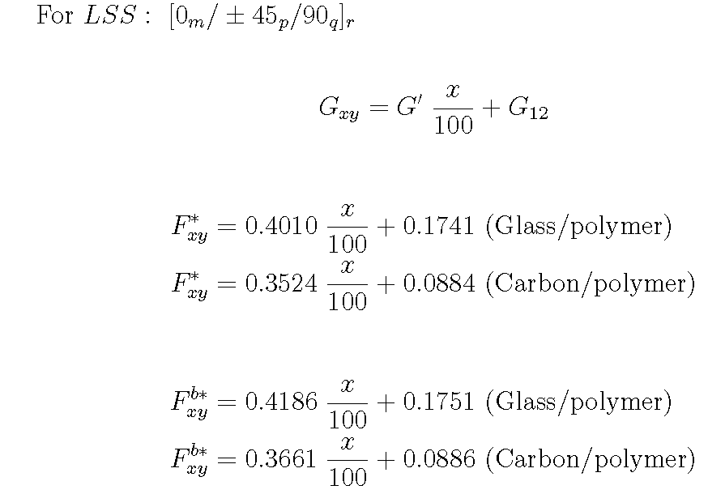
Universal shear stiffness G and strength F

Slide 14
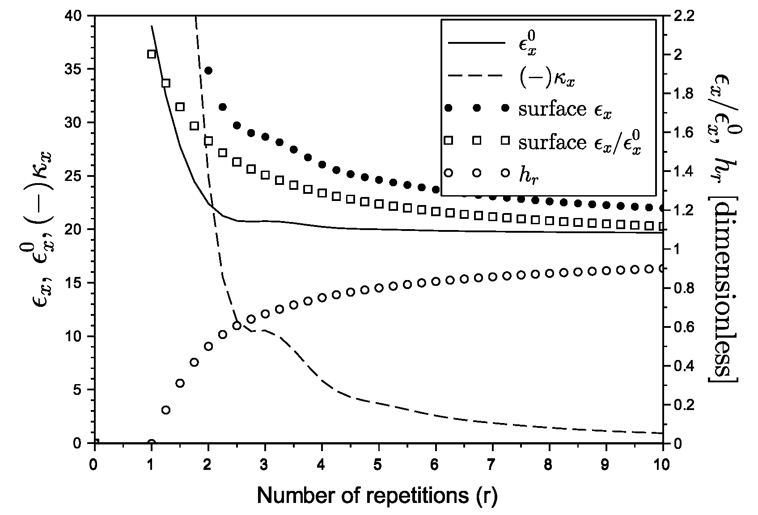
Homogeneization

Slide 15
Membrane design

Slide 16
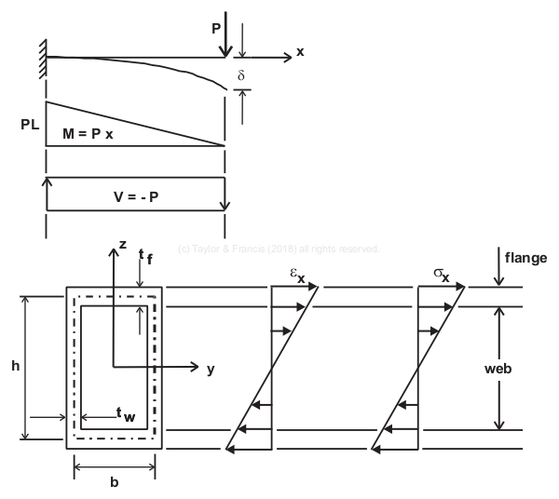
Design of a box beam

Slide 17
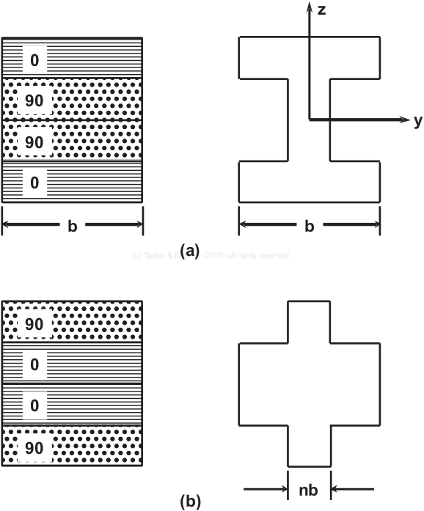
Transformed section method

Slide 18
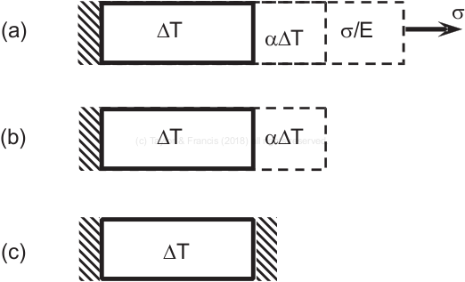
Thermal expansion

Slide 19
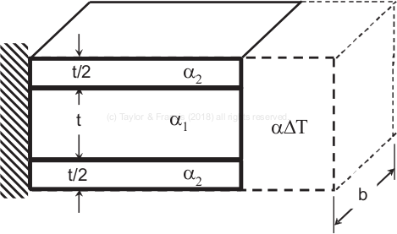
CTE mismatch

