Slide 1
Introduction to Composite Materials Design—3rd Edition
Chapter 5
©2018 by Taylor & Francis Group LLC, all rights reserved. See the front matter of the textbook for copyright information. Do not post electronically outside of course delivery systems where access is strictly restricted to students enrolled in your course.

Slide 2
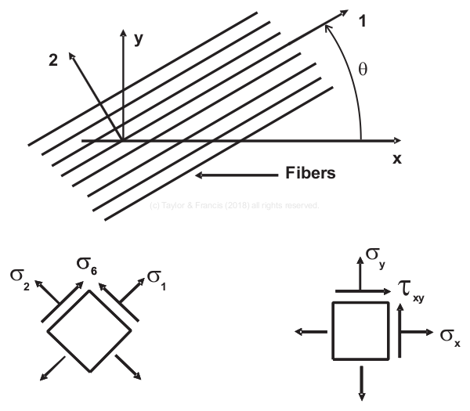
Lamina and laminate coordinate systems

Slide 3
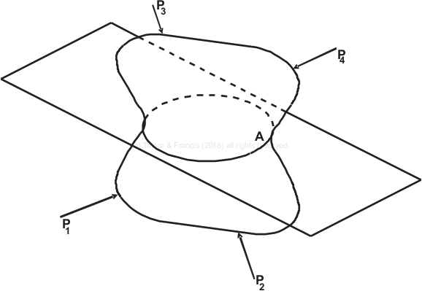
Equilibrium

Slide 4
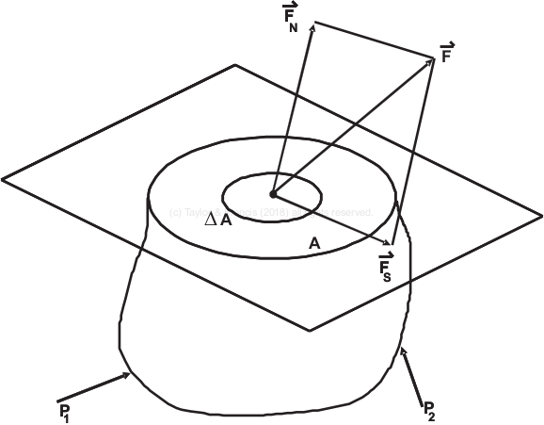
Internal forces

Slide 5
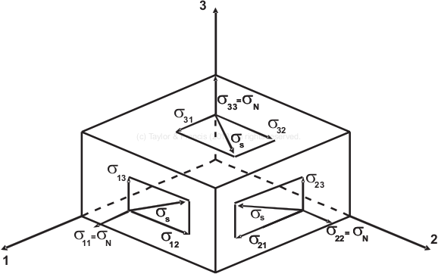
Components of stress

Slide 6
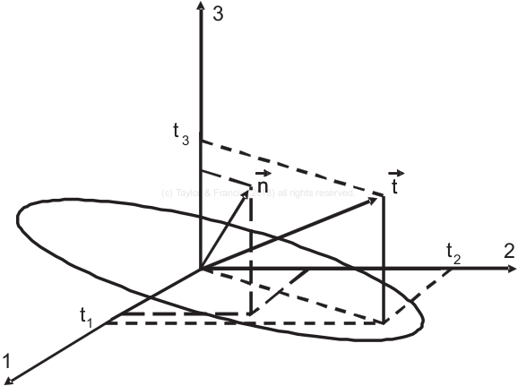
Stress vector

Slide 7
1D strain

Slide 8
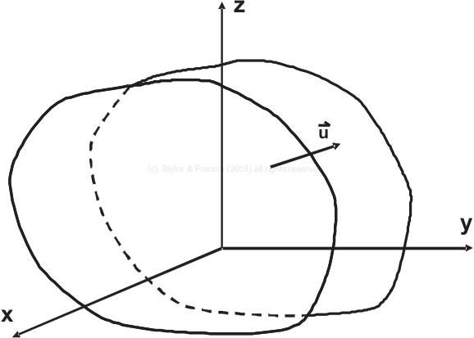
Displacement vector in space

Slide 9
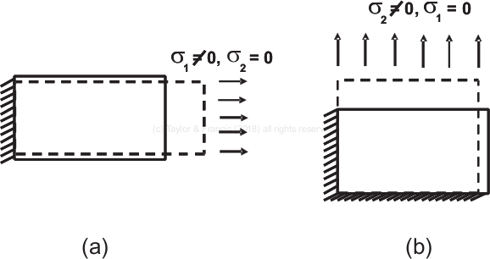
Determination of engineering properties

Slide 10
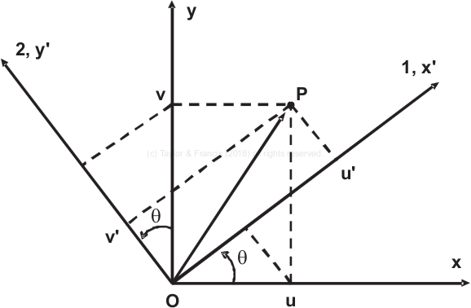
Coordinate transformation

