Slide 1
Introduction to Composite Materials Design—3rd Edition
Chapter 4
©2018 by Taylor & Francis Group LLC, all rights reserved. See the front matter of the textbook for copyright information. Do not post electronically outside of course delivery systems where access is strictly restricted to students enrolled in your course.

Slide 2
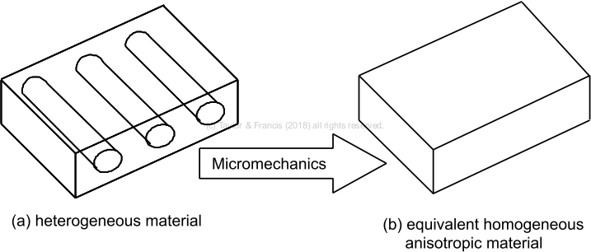
Micromechanics process

Slide 3
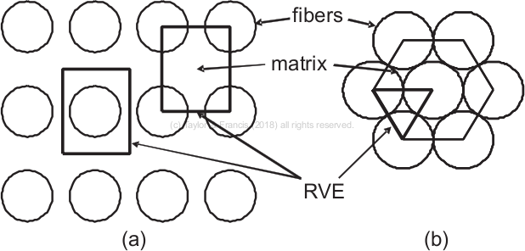
Representative volume element

Slide 4
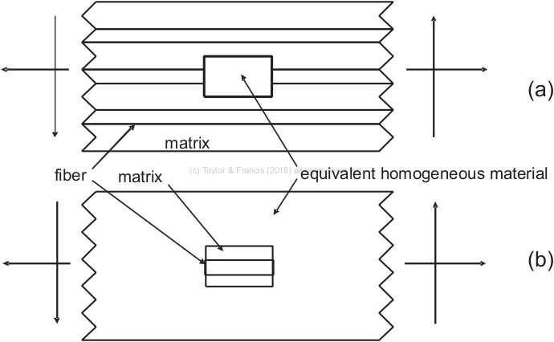
Equivalency between micro- and meso-scale

Slide 5
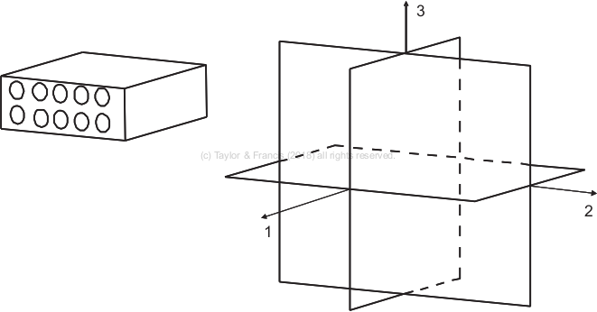
Orthotropic material

Slide 6
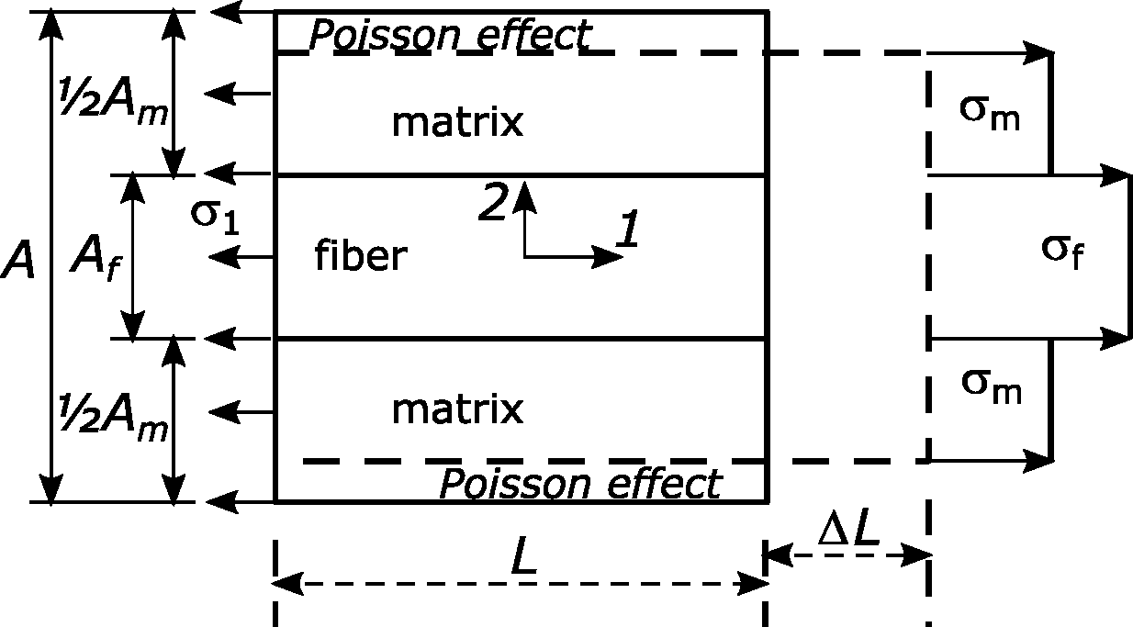
Determination of longitudinal properties

Slide 7
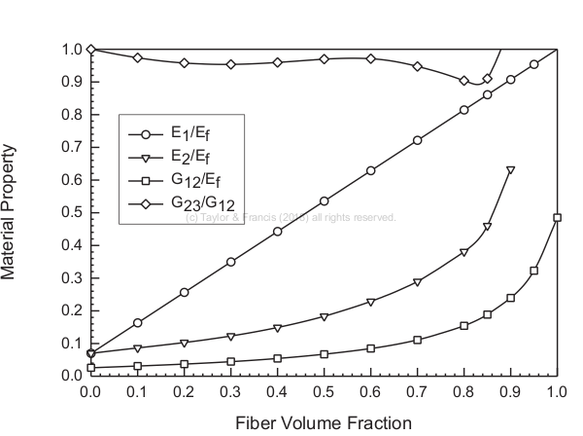
Comparison among elastic properties

Slide 8
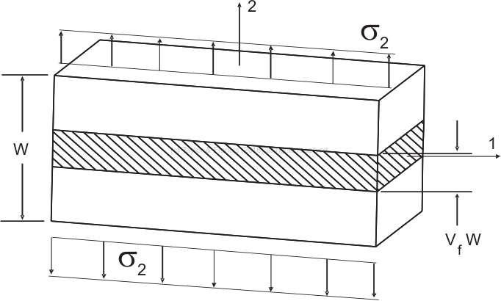
Determination of transverse properties

Slide 9
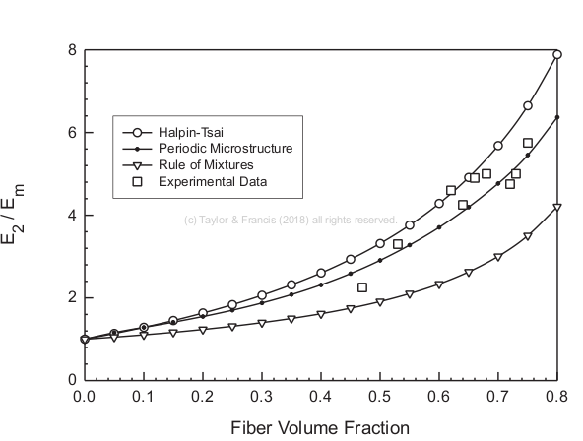
Comparison among several micromechanics models

Slide 10
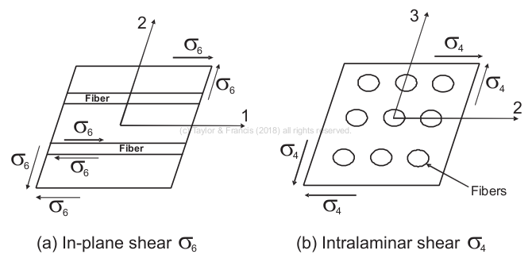
In-plane and intralaminar shear stress

Slide 11
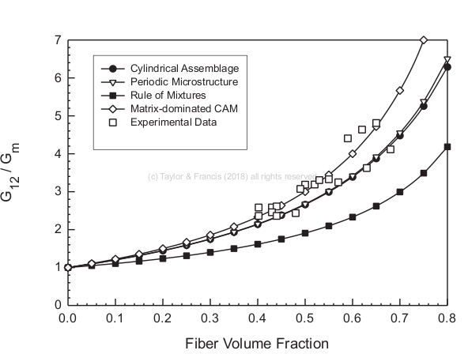
In-plane shear modulus from different models

Slide 12
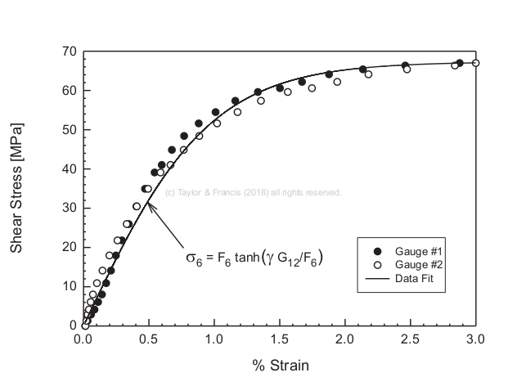
In-plane shear stress-strain behavior

Slide 13
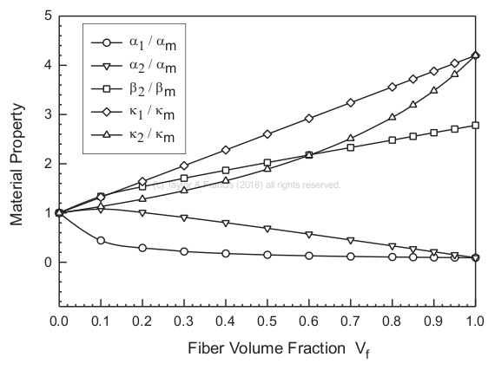
Transport properties

Slide 14
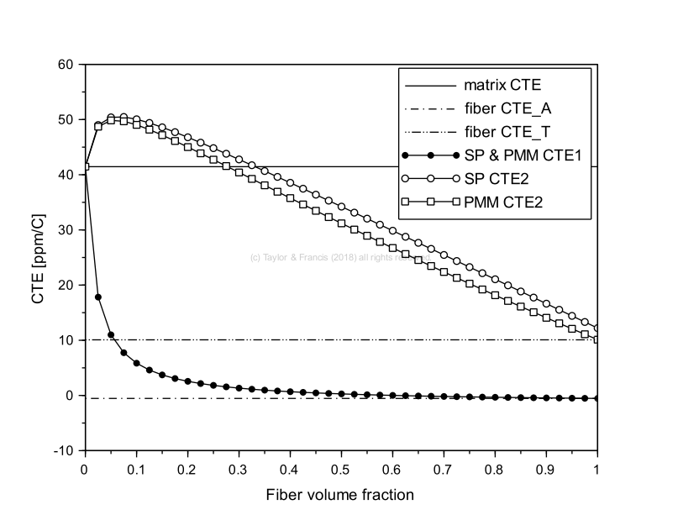
Coefficient of thermal expansion (CTE)

Slide 15
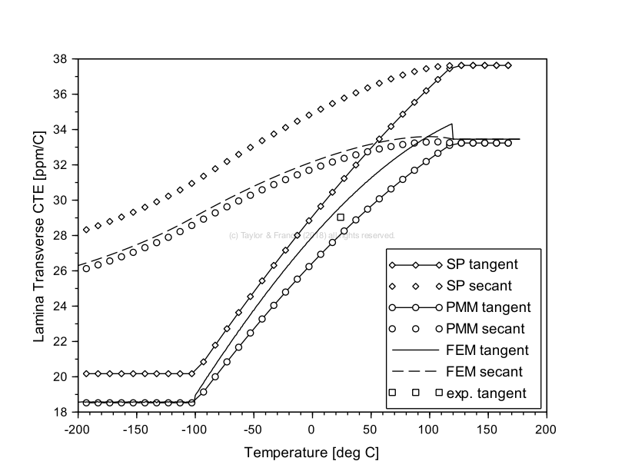
Prediction of transverse CTE

Slide 16
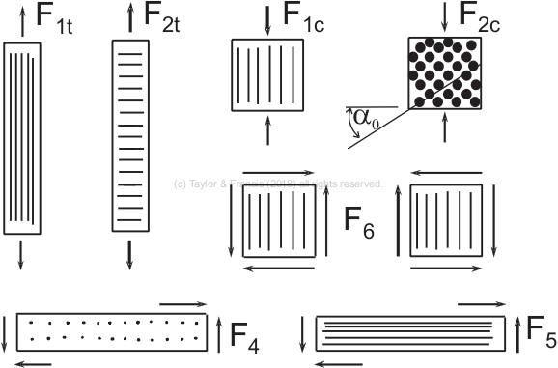
Strength values

Slide 17
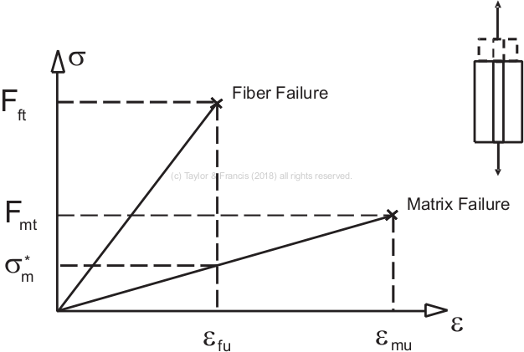
Longitudinal strength

Slide 18
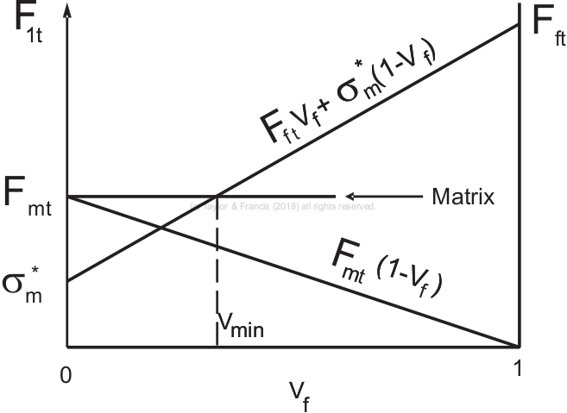
Applicability of strength equations

Slide 19
Corner crack in unidirectional lamina loaded transversally

Slide 20
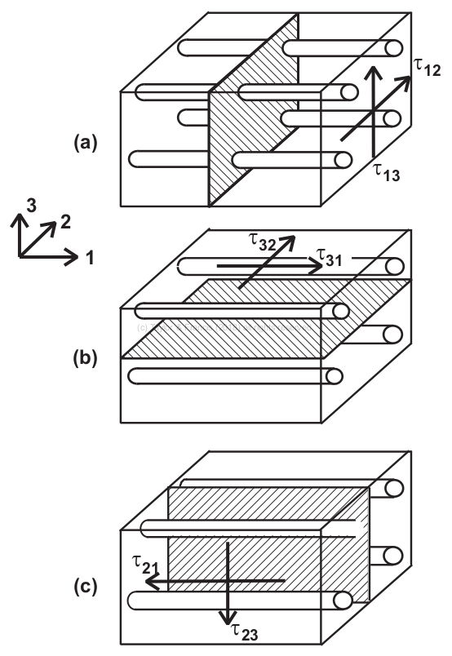
Shear components and shear failure modes

Slide 21
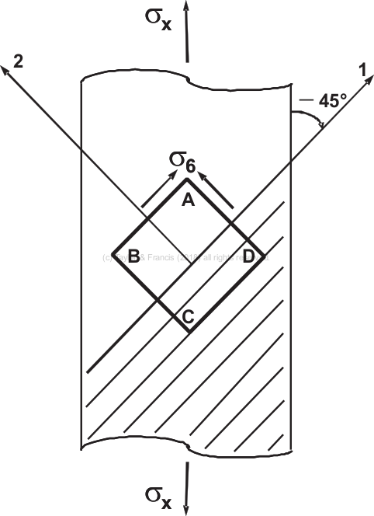
Most likely plane of shear

Slide 22
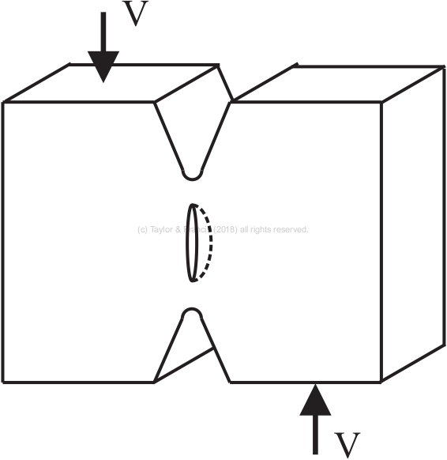
Surface crack in unidirectional lamina with shear loading

Slide 23
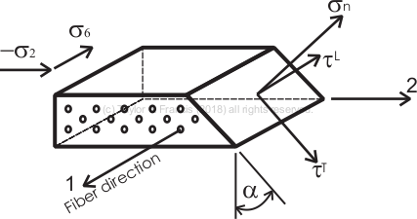
Unidirectional lamina under compression and shear

Slide 24
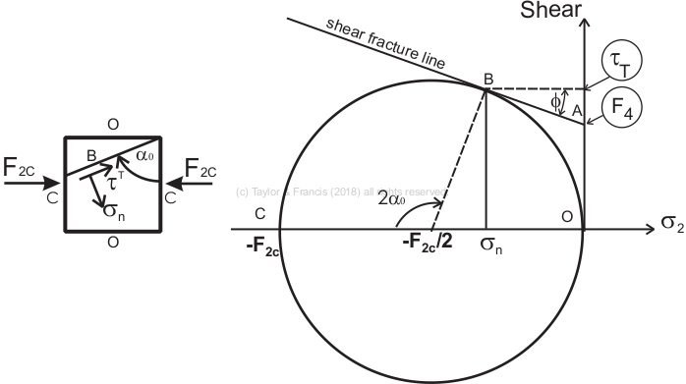
Mohr-Coulomb failure criterion

Slide 25
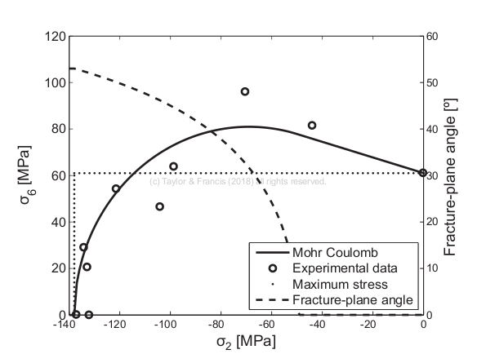
Comparison of MC criterion and data

