Slide 1
Introduction to Composite Materials Design—3rd Edition
Chapter 3
©2018 by Taylor & Francis Group LLC, all rights reserved. See the front matter of the textbook for copyright information. Do not post electronically outside of course delivery systems where access is strictly restricted to students enrolled in your course.

Slide 2
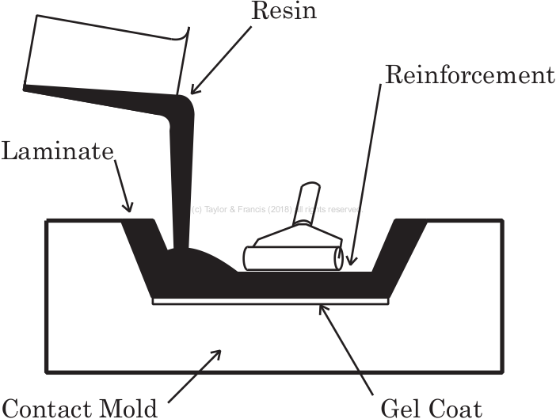
Hand layup

Slide 3
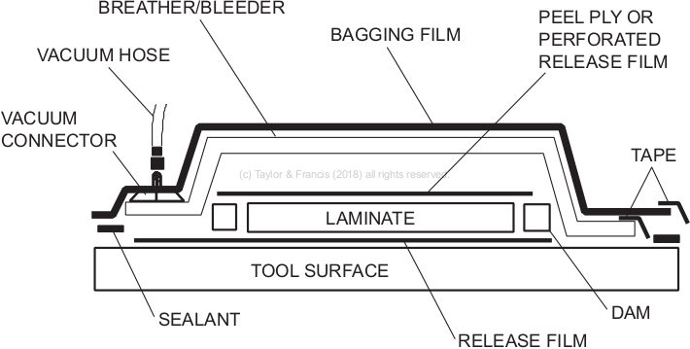
Vacuum bagging

Slide 4
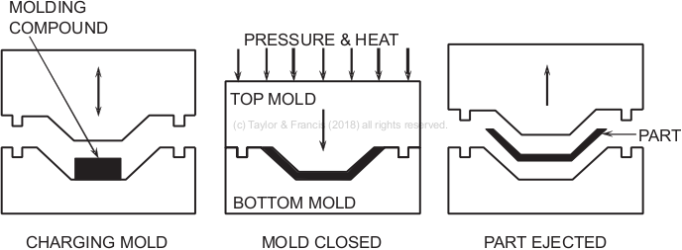
Compression molding

Slide 5
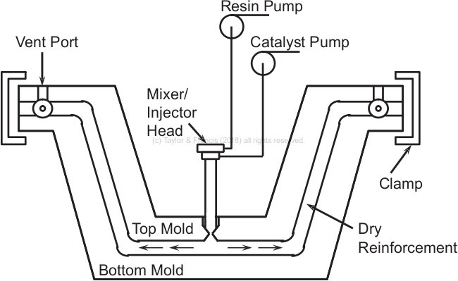
Resin transfer molding

Slide 6
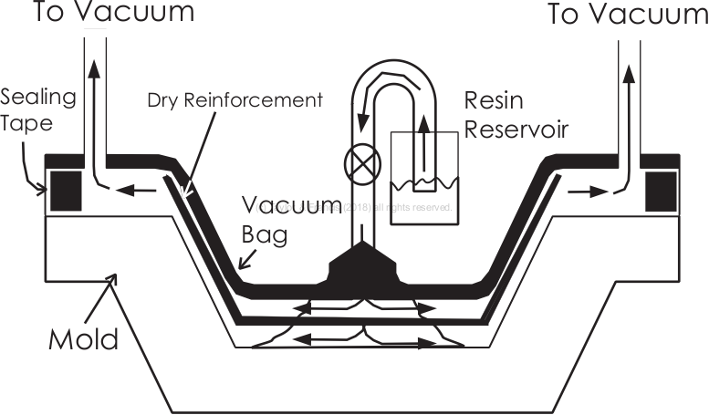
Vacuum-assisted resin transfer molding

Slide 7
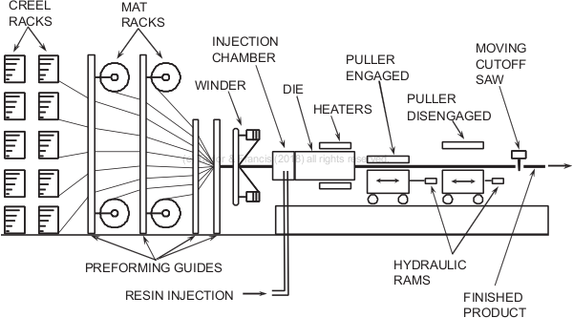
Pultrusion

Slide 8
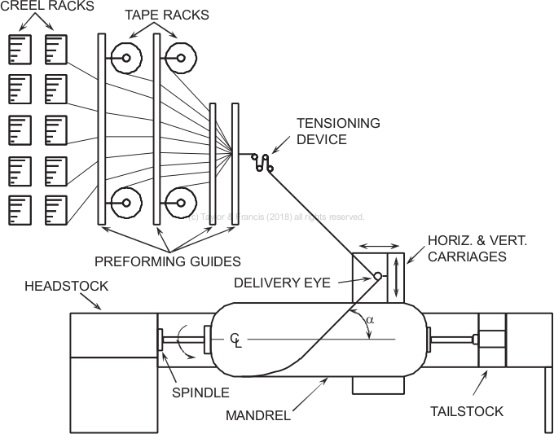
Filament winding

Slide 9
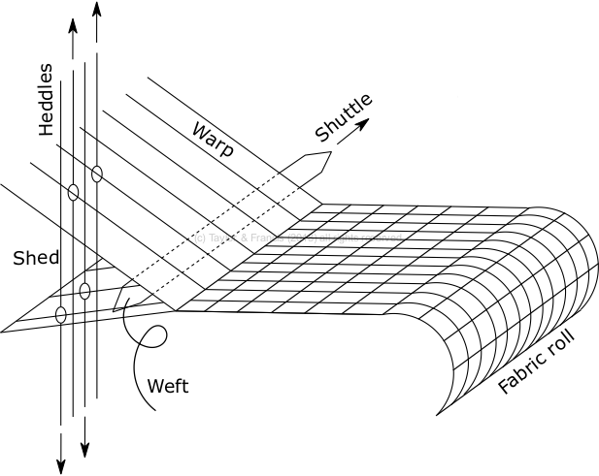
A loom to produce woven fabrics

Slide 10
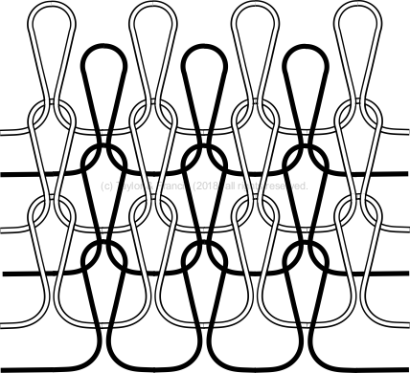
Knitted fabric

Slide 11
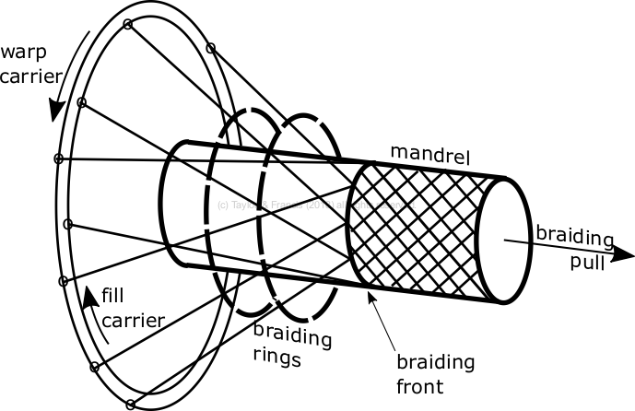
Braiding machine

Slide 12
Stitched fabric

