Slide 1
Introduction to Composite Materials Design—3rd Edition
Chapter 2
©2018 by Taylor & Francis Group LLC, all rights reserved. See the front matter of the textbook for copyright information. Do not post electronically outside of course delivery systems where access is strictly restricted to students enrolled in your course.

Slide 2
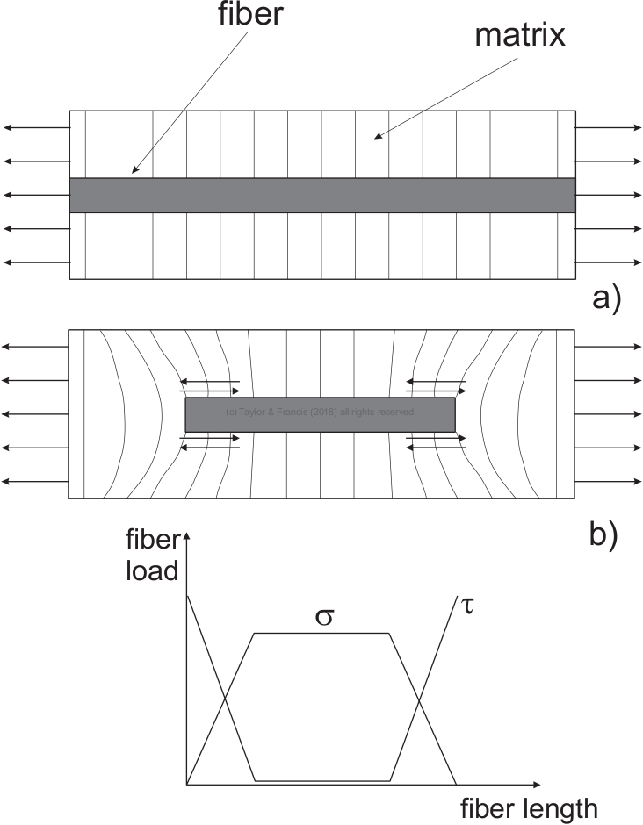
Load transfer between fiber and matrix

Slide 3
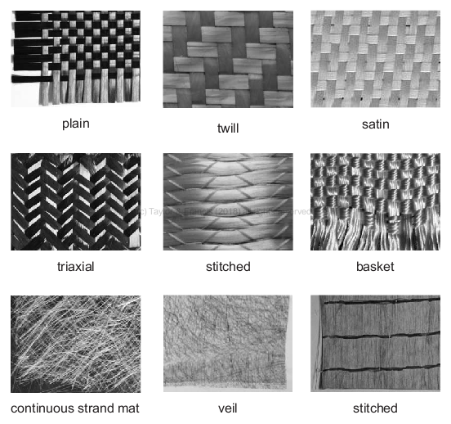
Fiber forms

Slide 4
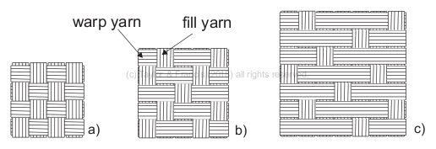
Weaving patterns

Slide 5
Woven fabrics

Slide 6
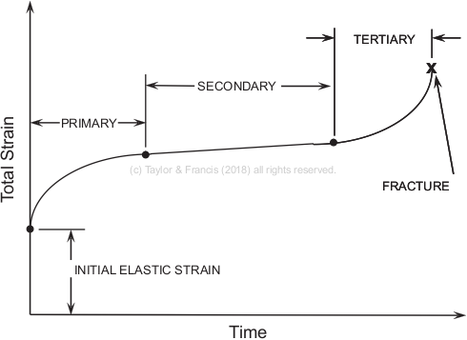
Creep test

Slide 7
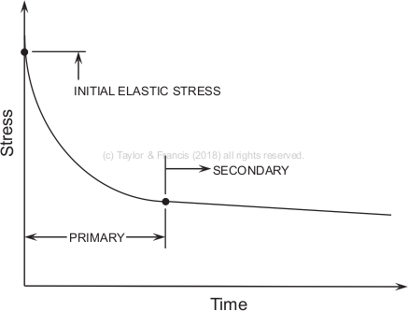
Relaxation test

Slide 8
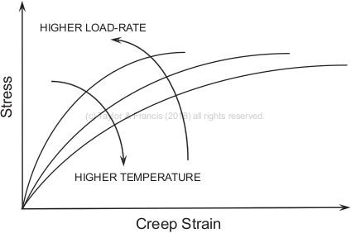
Loading rate and temperature

