Slide 1
Introduction to Composite Materials Design—3rd Edition
Chapter 13
©2018 by Taylor & Francis Group LLC, all rights reserved. See the front matter of the textbook for copyright information. Do not post electronically outside of course delivery systems where access is strictly restricted to students enrolled in your course.

Slide 2
Reinforced concrete beam

Slide 3
Concrete beam strengthened with FRP

Slide 4
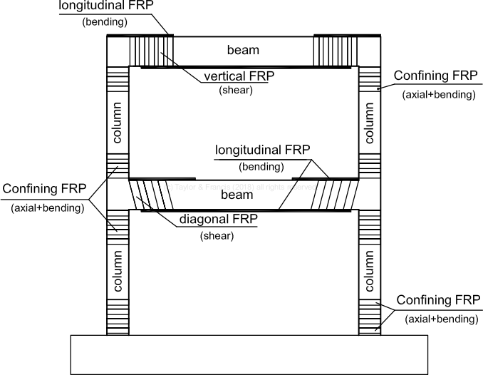
Strengthening of beams and columns

Slide 5
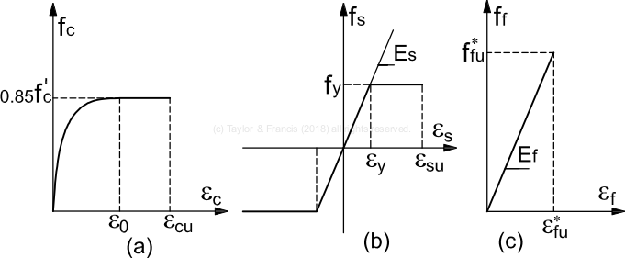
Stress strain behavior of (a) concrete, (b) steel, and (c) FRP

Slide 6
Failure modes

Slide 7
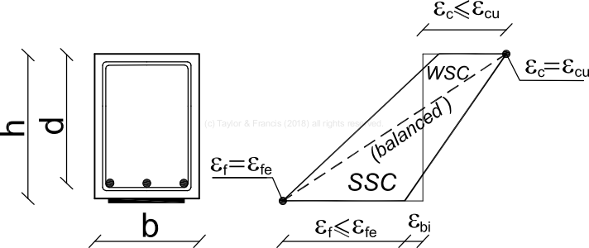
Strong Strengthening Configuration (SSC) and Weak Strengthening Configuration (WSC)

Slide 8
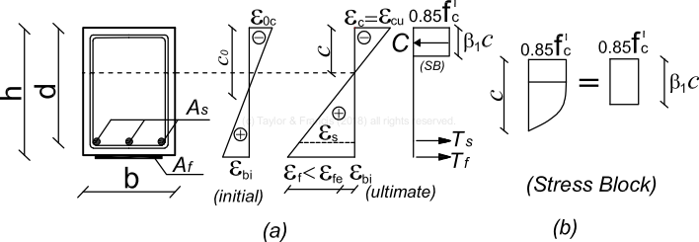
SSC: stress, strain, and stress block

Slide 9
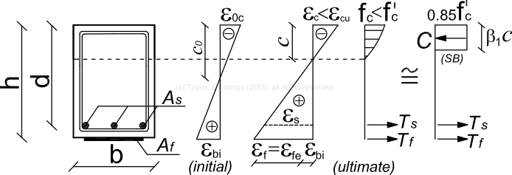
WSC: stress, strain, and stress block

Slide 10
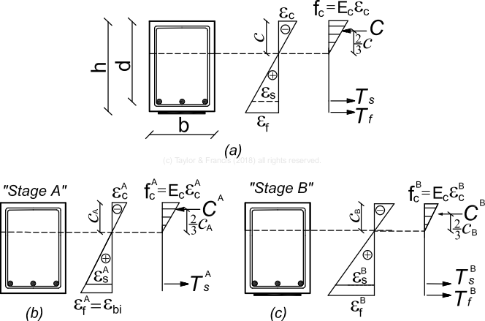
Serviceability limit state

Slide 11
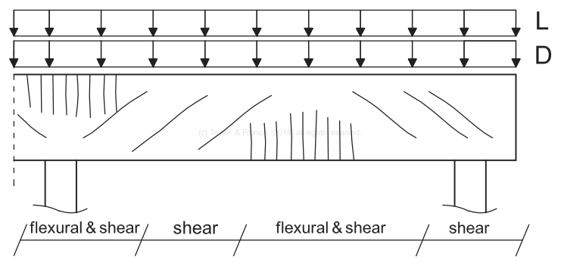
Crack pattern on continuous RC beam

Slide 12
Crack pattern on simply supported RC beam

Slide 13
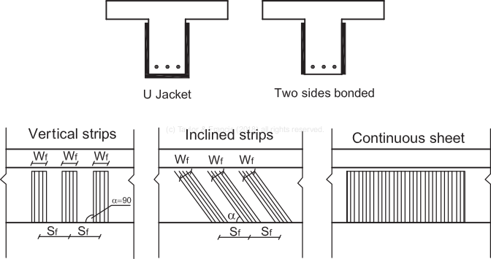
Shear strengthening

Slide 14
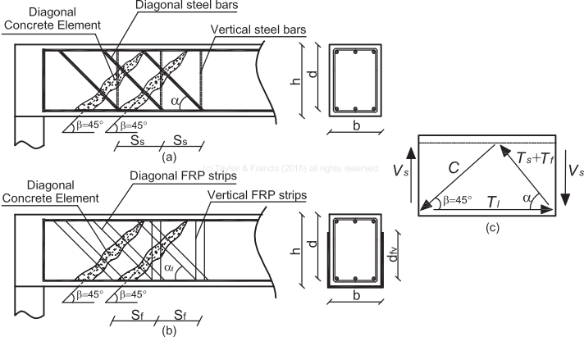
Shear strengthening

Slide 15
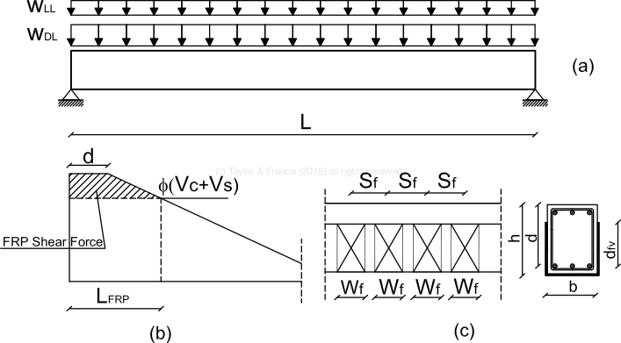
Shear strengthening

Slide 16
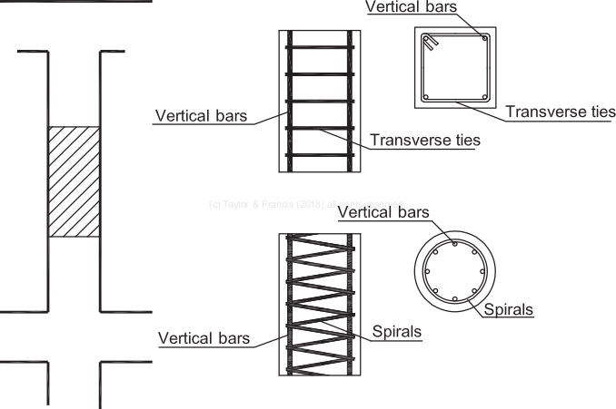
Column strengthening

Slide 17
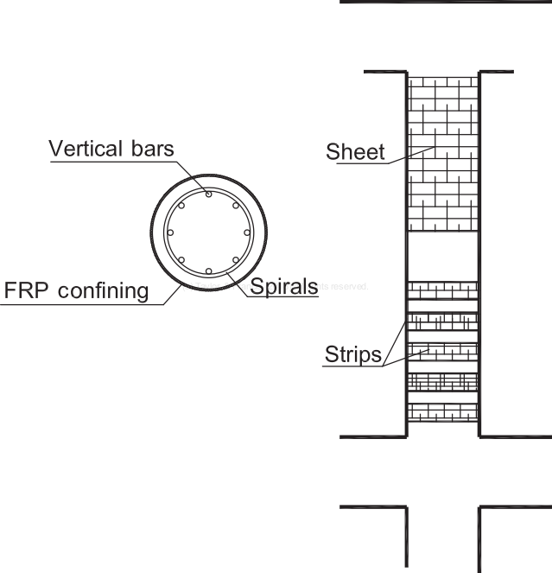
Detail of FRP reinforcement of column

Slide 18
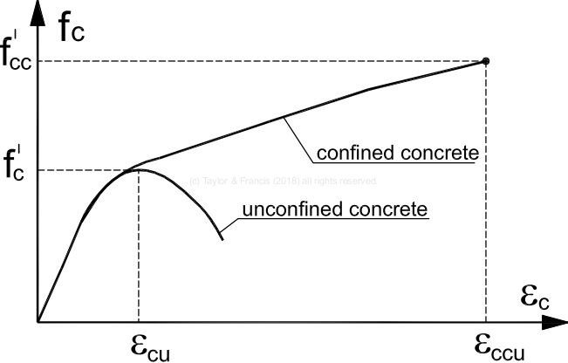
Confinement effect on concrete

Slide 19
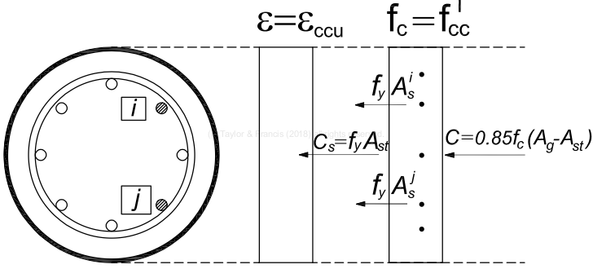
Colum geometry, stress, and strain

Slide 20
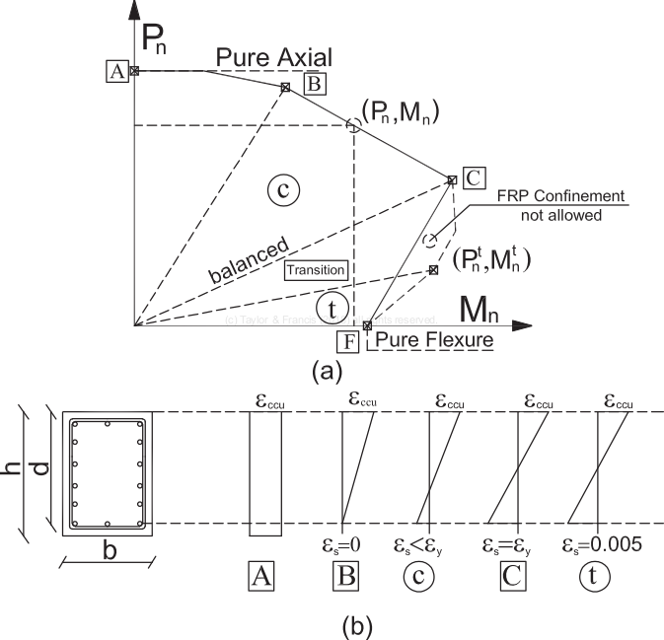
Interaction diagram for beam-column

Slide 21
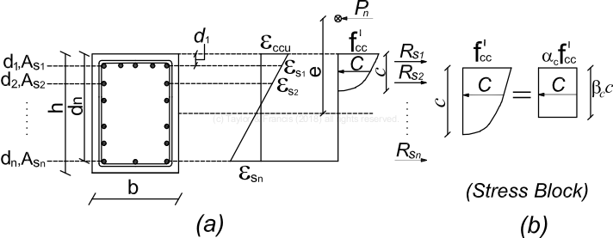
Stress, strain, and stress block for beam-column

Slide 22
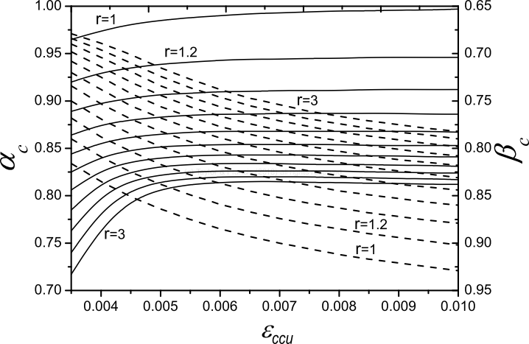
Confined stress-block parameters for concrete

Slide 23
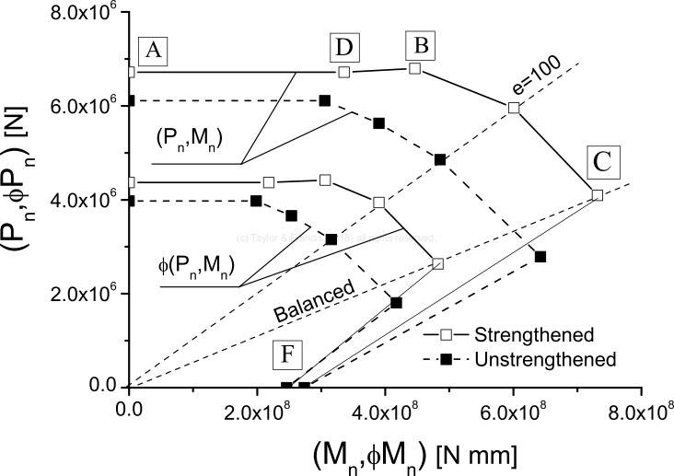
Design validation diagram for beam-column

