Slide 1
Introduction to Composite Materials Design—3rd Edition
Chapter 12
©2018 by Taylor & Francis Group LLC, all rights reserved. See the front matter of the textbook for copyright information. Do not post electronically outside of course delivery systems where access is strictly restricted to students enrolled in your course.

Slide 2
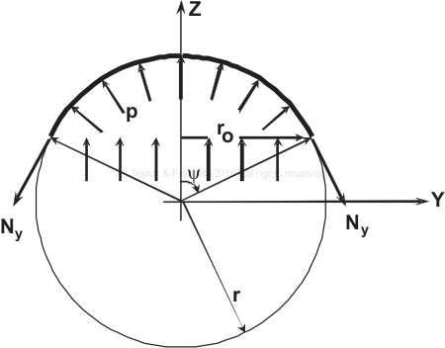
Membrane hoop load in cylindrical pipe

Slide 3
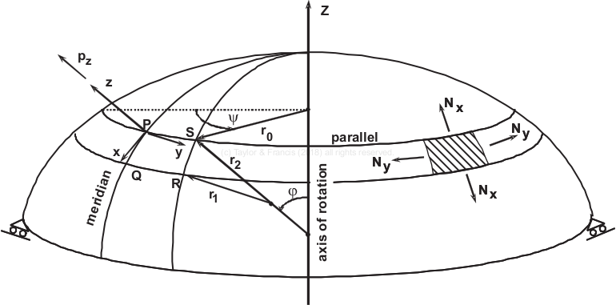
Geometry and coordinate system for shells of revolution

Slide 4
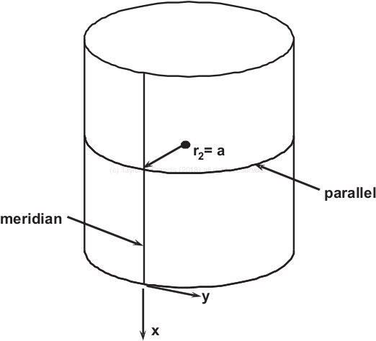
Circular cylindrical shell

Slide 5
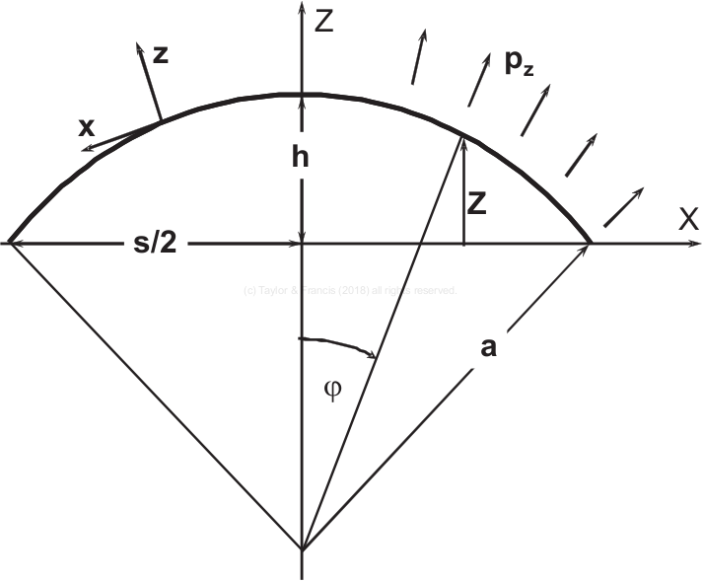
Spherical dome

Slide 6
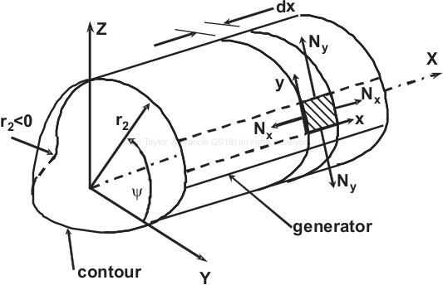
Prismatic shell with general cross section

Slide 7
Simply supported pipe

