Slide 1
Introduction to Composite Materials Design—3rd Edition
Chapter 11
©2018 by Taylor & Francis Group LLC, all rights reserved. See the front matter of the textbook for copyright information. Do not post electronically outside of course delivery systems where access is strictly restricted to students enrolled in your course.

Slide 2
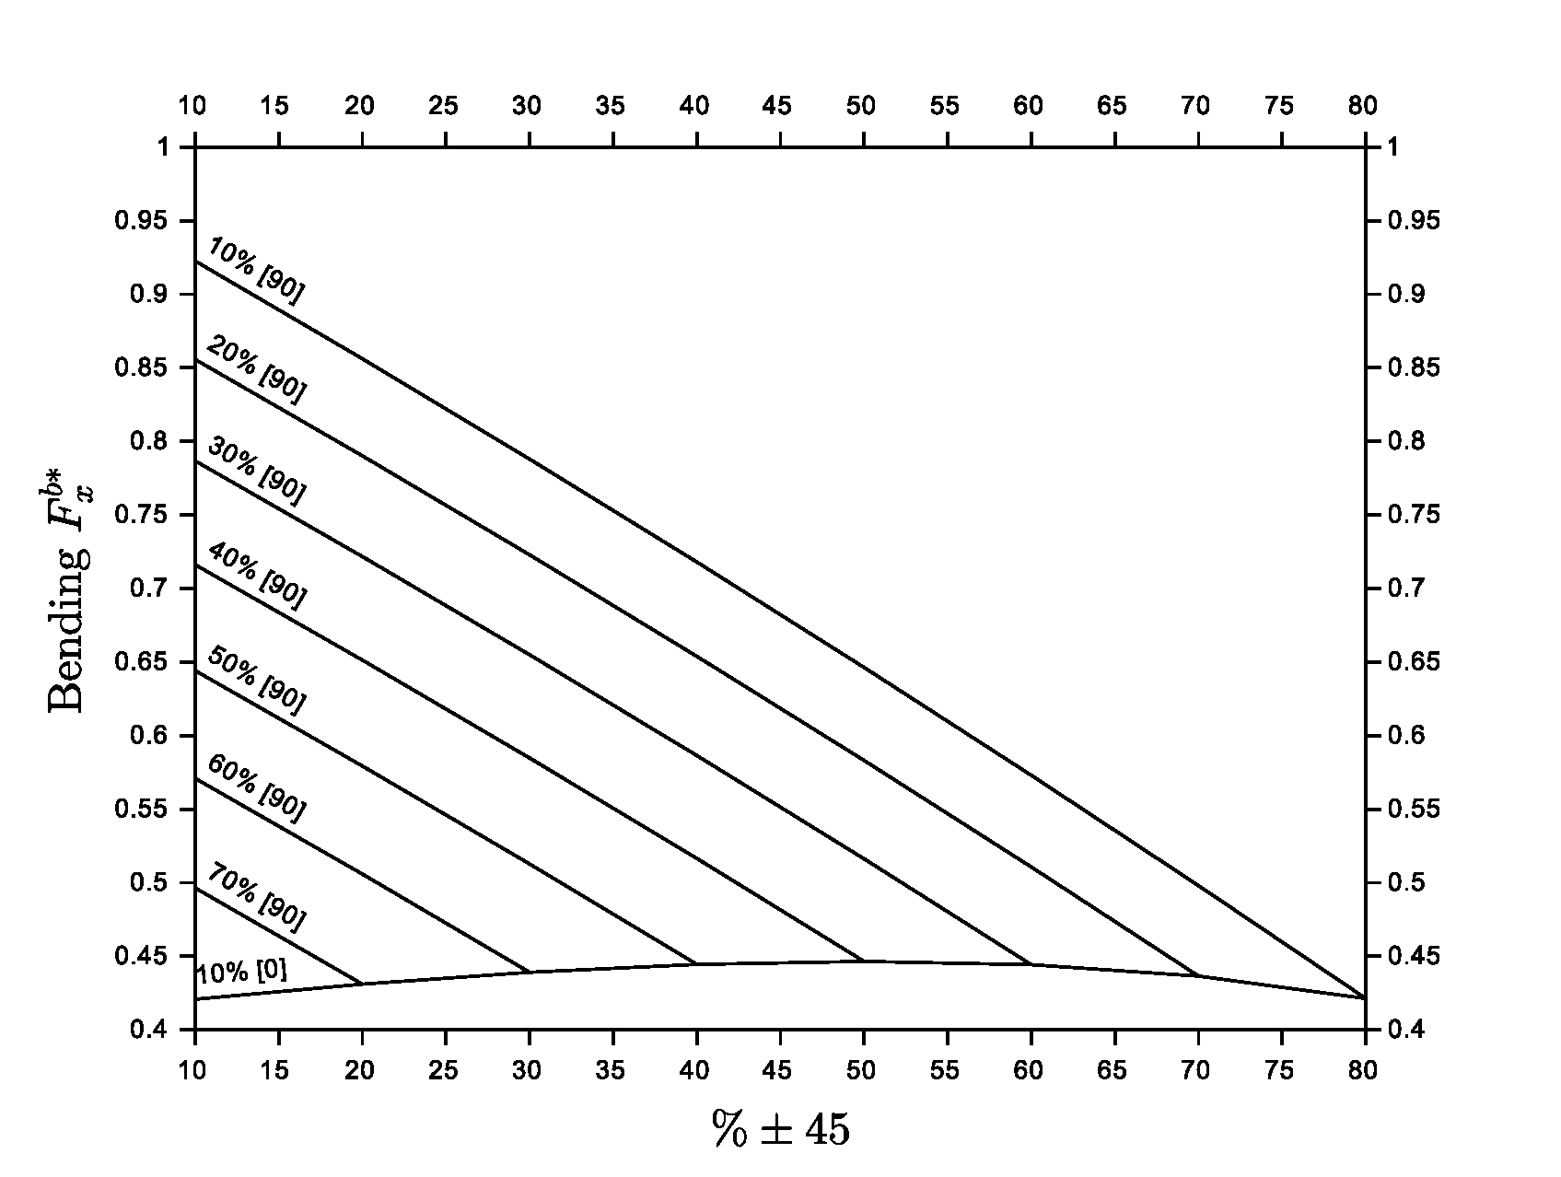
Universal carpet plot for bending strength, Glass/polymer laminates

Slide 3
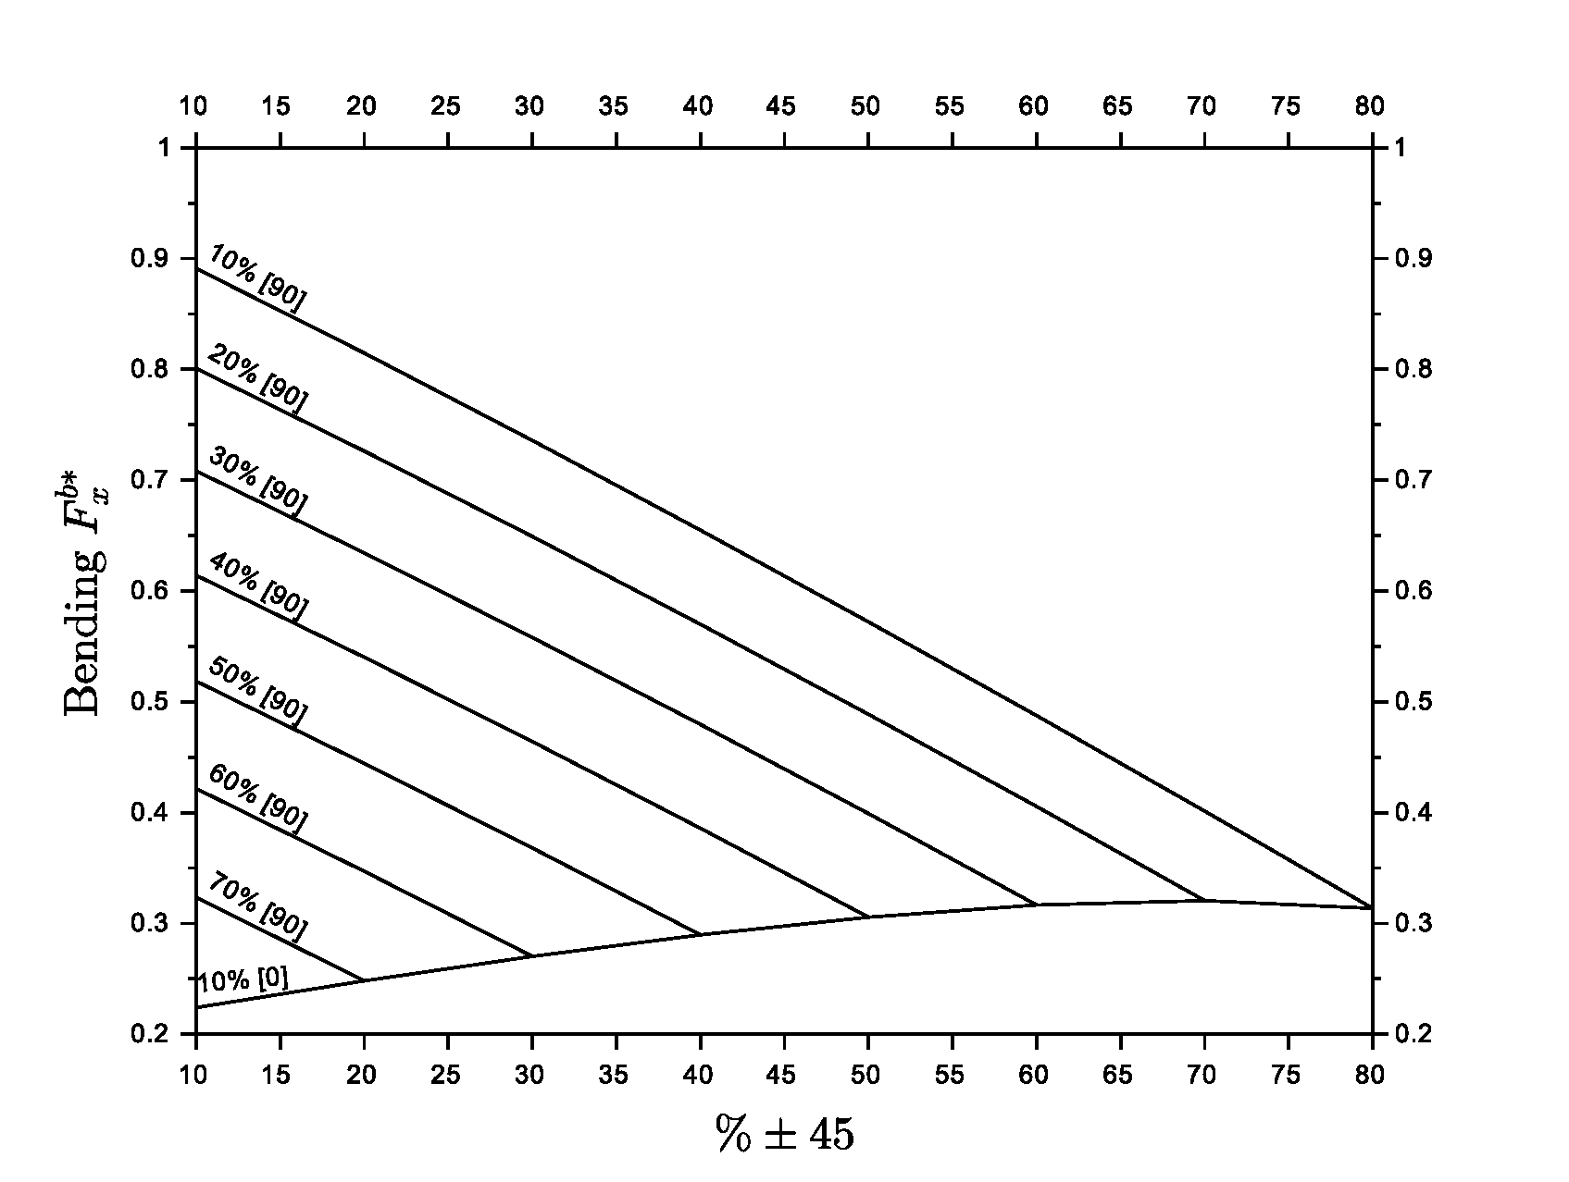
Universal carpet plot for bending strength, carbon/polymer laminates

Slide 4
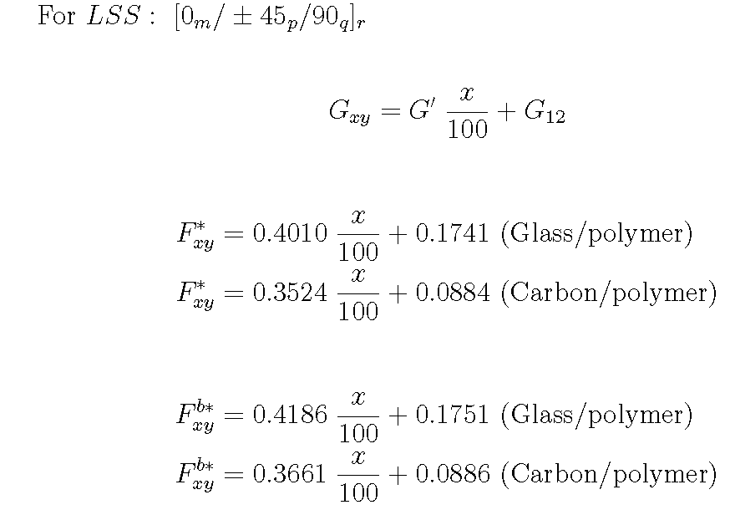
Universal equations for shear

Slide 5
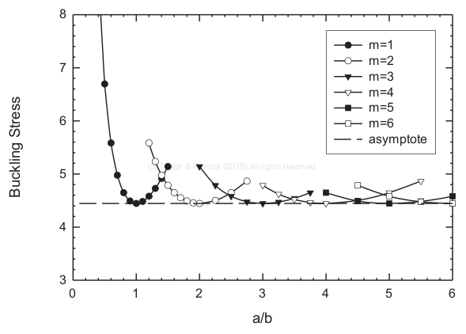
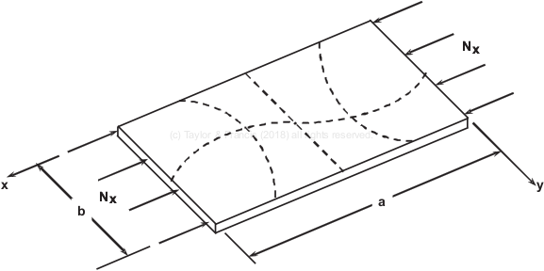
Buckling, all edges simply supported

Slide 6
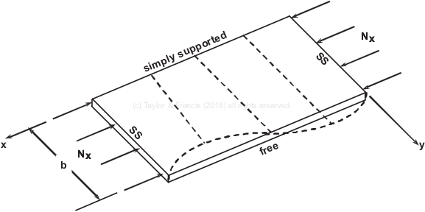
Buckling with one free edge

Slide 7
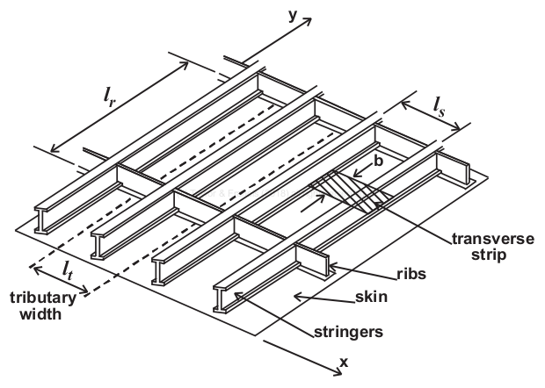
Stiffened panel

Slide 8
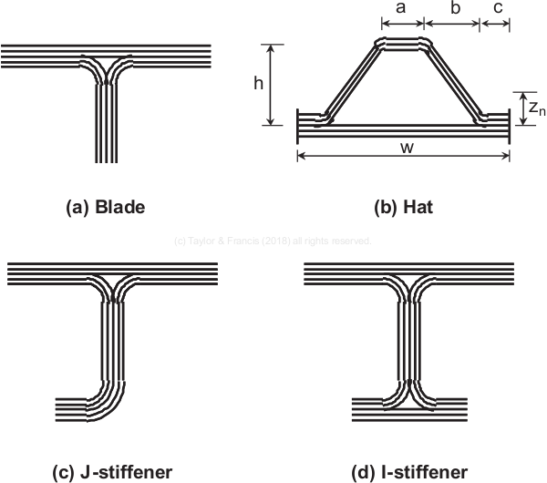
Popular stiffener geometries

Slide 9
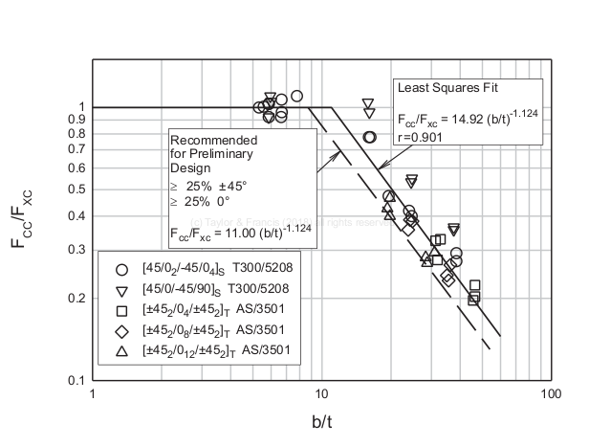
Crippling data, no free edge case

Slide 10
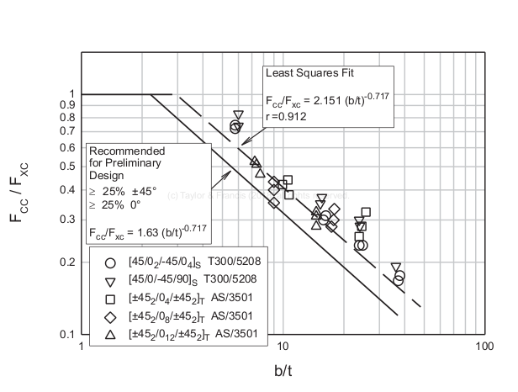
Crippling data, one free edge case

Slide 11
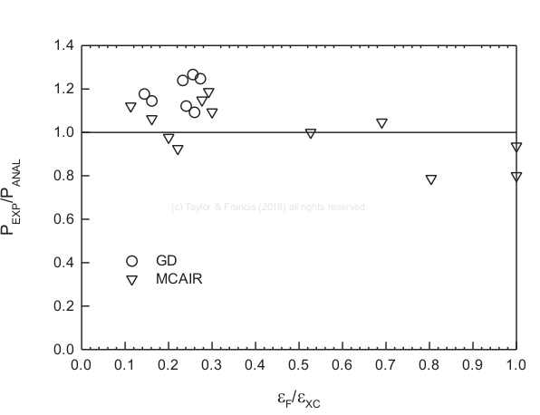
Stiffener crippling data

Slide 12
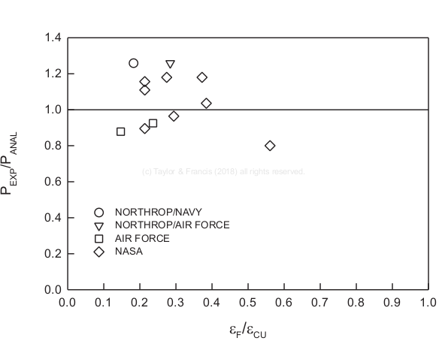
Buckling of stiffened panel with edge load

