Slide 1
Introduction to Composite Materials Design—3rd Edition
Chapter 10
©2018 by Taylor & Francis Group LLC, all rights reserved. See the front matter of the textbook for copyright information. Do not post electronically outside of course delivery systems where access is strictly restricted to students enrolled in your course.

Slide 2
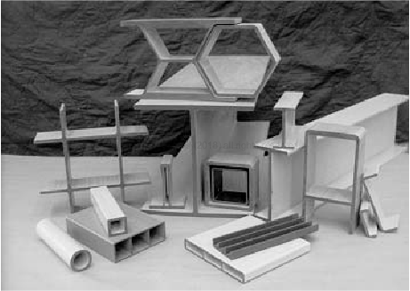
Structural shapes by pultrusion

Slide 3
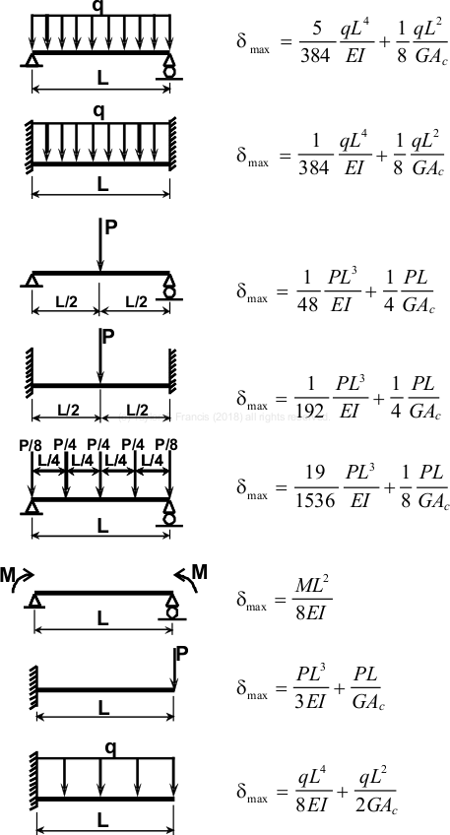
Deflections of beams including shear deformation

Slide 4
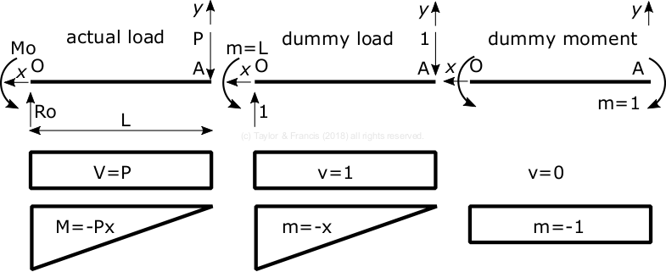
Dummy load method

Slide 5
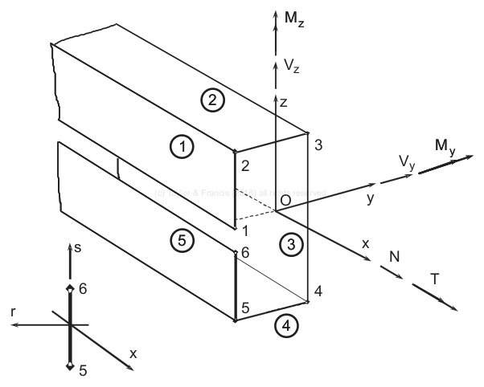
Local and global coordinate systems

Slide 6
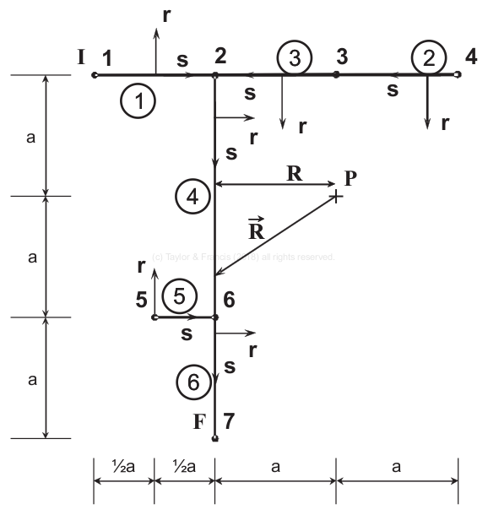
Node and segment numbering convention

Slide 7
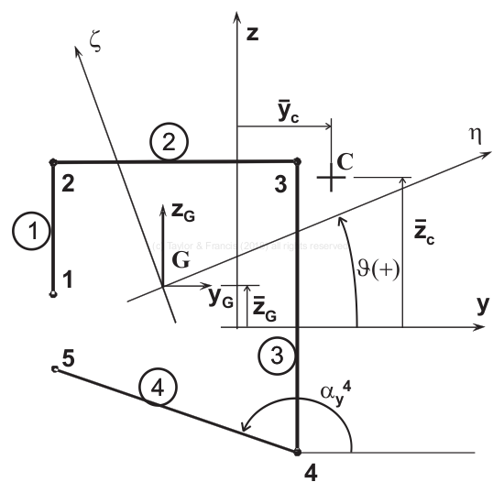
Principal axes of bending

Slide 8
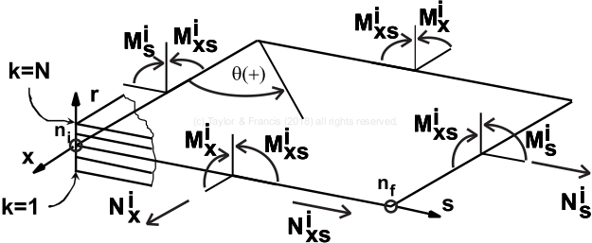
Stress resultants in the i-th wall (segment)

Slide 9
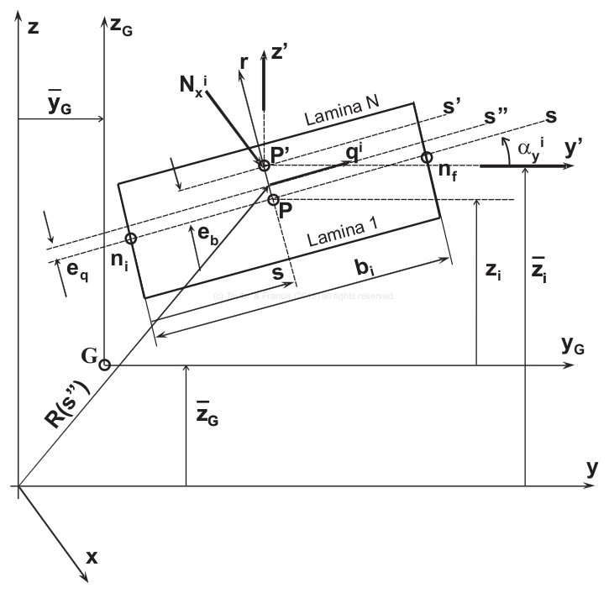
Definition of variables on the cross section of the i-th segment

Slide 10
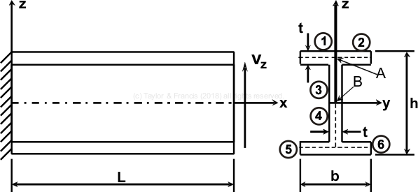
Example 10.5

Slide 11
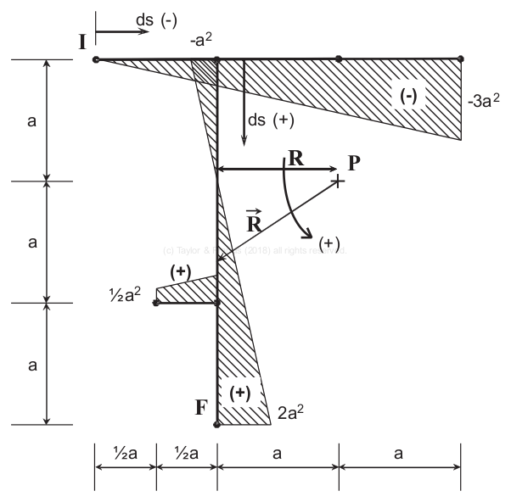
Sectorial area diagram

Slide 12
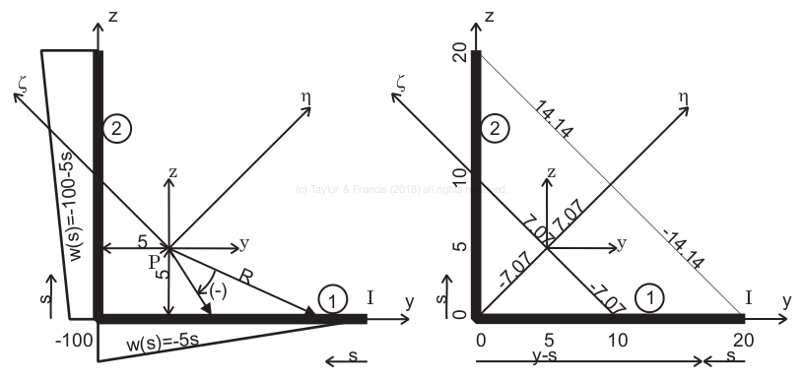
Examples 10.6 and 10.10

Slide 13
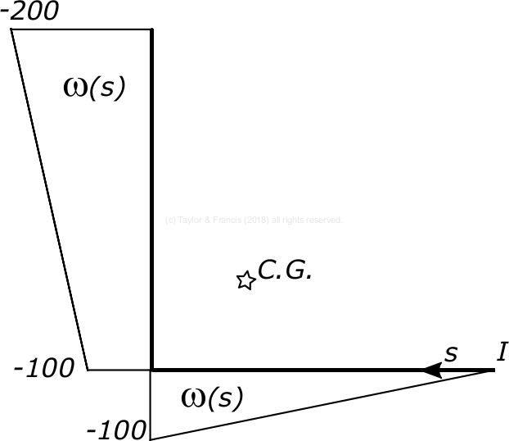
Sectorial area diagram for example 10.10

