Slide 1
Introduction to Composite Materials Design—3rd Edition
Chapter 1
©2018 by Taylor & Francis Group LLC, all rights reserved. See the front matter of the textbook for copyright information. Do not post electronically outside of course delivery systems where access is strictly restricted to students enrolled in your course.

Slide 2
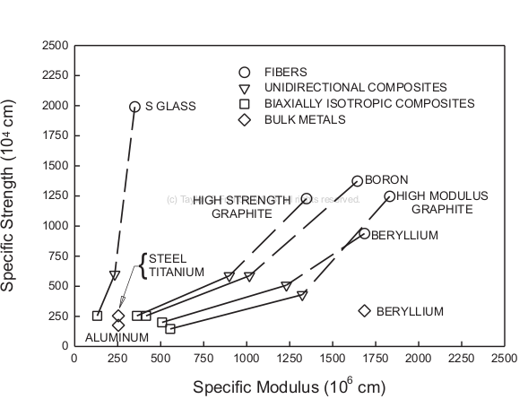
Specific strength and stiffness comparison

Slide 3
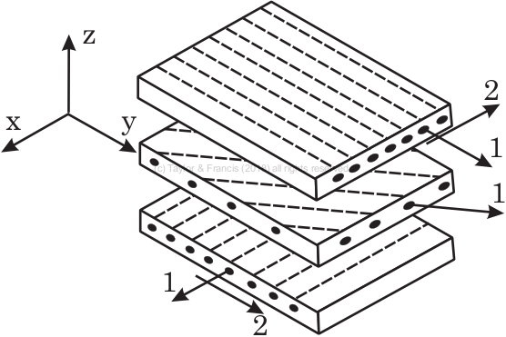
Assembly of three laminas into a laminate

Slide 4
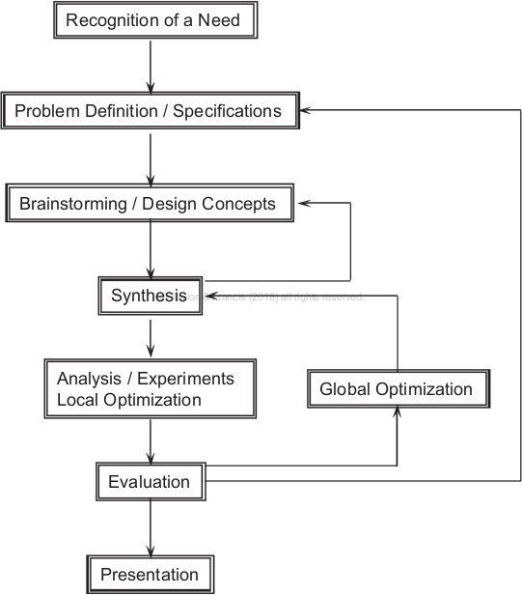
The design process

Slide 5
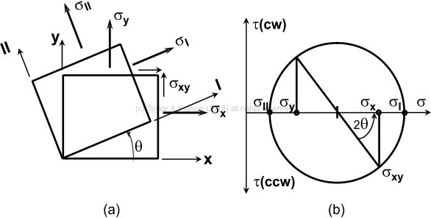
Mohr’s circle for stress transformation

Slide 6
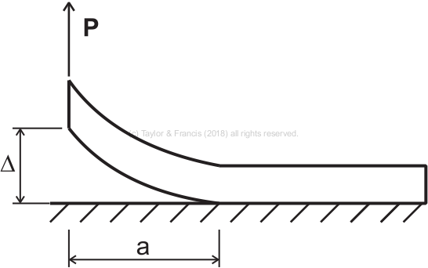
Beam peeling of from a substrate

Slide 7
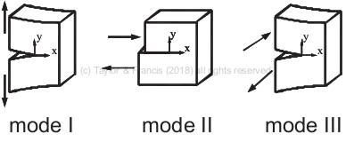
Fracture modes

Slide 8
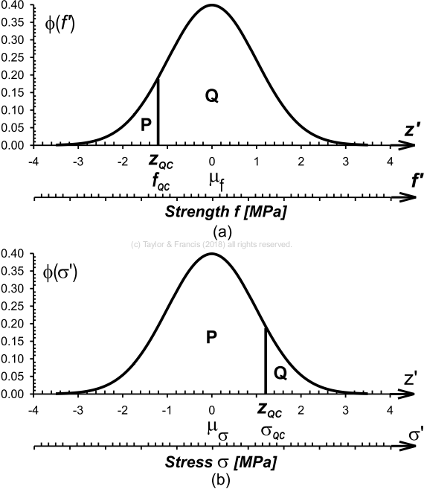
Standard normal-probability density

Slide 9
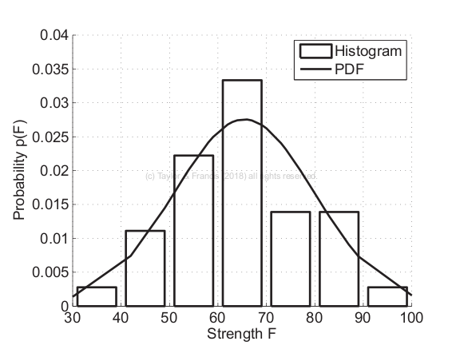
Histogram

