Slide 1
Introduction to Composite Materials Design—3rd Edition
Appendix
©2018 by Taylor & Francis Group LLC, all rights reserved. See the front matter of the textbook for copyright information. Do not post electronically outside of course delivery systems where access is strictly restricted to students enrolled in your course.

Slide 2
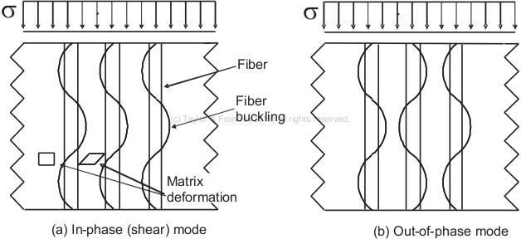
Modes of fiber microbuckling

Slide 3
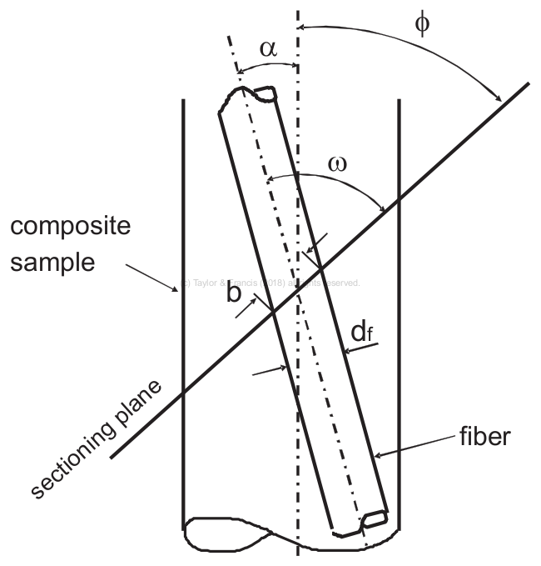
Misalignment measuring technique

Slide 4
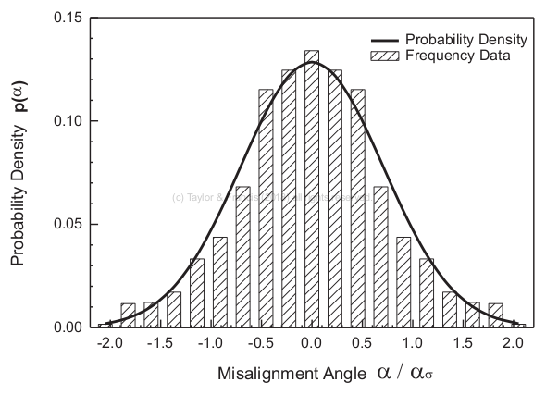
Probability density function

Slide 5
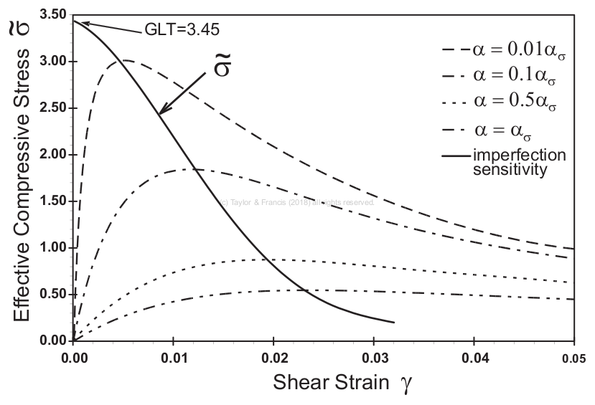
Equilibrium states

Slide 6
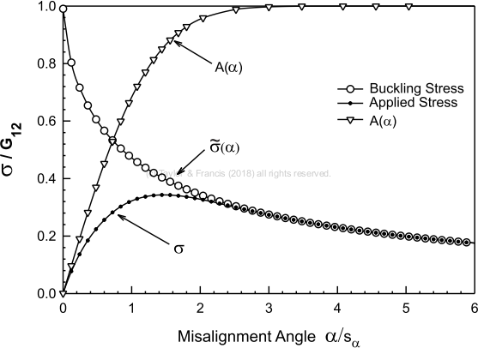
Buckling and applied stress

