Slide 1
Introduction to Composite Materials Design
Chapter 7: strength
Introduction to Composite Materials Design—Third Edition
Dr. Ever J. Barbero
November 24, 2018

Slide 2
7.0. Introduction
Fig. 6.2

Slide 3
7.0. Modes of fracture

Slide 4
7.0. Review micromechanics
Longitudinal tension:.......
Longitudinal compression:
Transverse tension:………
Transv. compression:
Out-of-plane shear:.......
In-plane shear:………………..

Slide 5
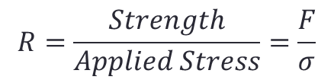
7.1.1. Strength ratio
$$R=\frac{Strength}{Applied Stress}=\frac{F}{σ}$$
This is for a single lamina! Not for a laminate!
For a laminate we use FPF and LPF defined later.

Slide 6
7.1.2. Maximum stress

Slide 7
7.1.2. Max. stress, cont’d

Slide 8
7.1.3. Max. strain

Slide 9
7.1.4. Interacting failure criterion
Longitudinal tensile strength is fiber dominated, thus uncoupled from anything else.
Longitudinal compressive strength is fiber and matrix influenced, so it is coupled (G₁₂ is matrix dominated)

Slide 10
7.1.4. Interacting (cont’d)
Matrix dominated strengths:
  Transverse tensile strength F_{2T}
  In-plane shear F₆
  Out-of-plane shear F₄
Since all three are matrix dominated, they interact!

Slide 11
7.1.4. interacting (cont’d)

Slide 12
7.2. Laminate First Ply Failure (FPF)

Slide 13
7.2. FPF
Use some interacting failure criterion
  R₁ = <F_{1t} /s₁> + <-F_{1c} /s₁>
  R2 = [ - b +/- sqrt { b² + 4 a } ] / (2a)
Compute the minimum R in each lamina
  R^{(k)}=min(R₁, R₂, R₆) in lamina k
Find the lamina that has the smallest R^{(k)}
  R = min(R^{(k)})
  R is the strength ratio of the whole laminate
If R<1, then the lamina with the min(R) fails.
  The thickness or strength must be increased, or the load decreased
If R>1, R is the safety factor in allowable stress design
Allowable stress design (ASD) is not used any more. Instead, use Load Resistance Factor Design (LRFD) or better reliability analysis.

Slide 14
FPF (cont’d)
The fact that one lamina fails does not mean the laminate fails unless it is poorly designed
Acceptable design? Start with the 10% rule
  At least 10% thickness of 0-deg
  At least 10% thickness of 90-deg
  At least 10% thickness of +/-45

Slide 15
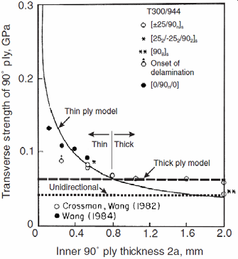
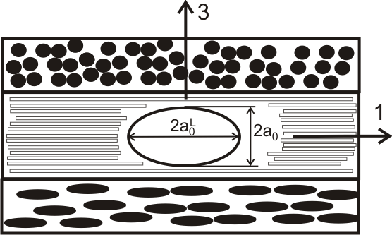
7.2.1. In-situ strength affects FPF
Fig. 7.8

Slide 16
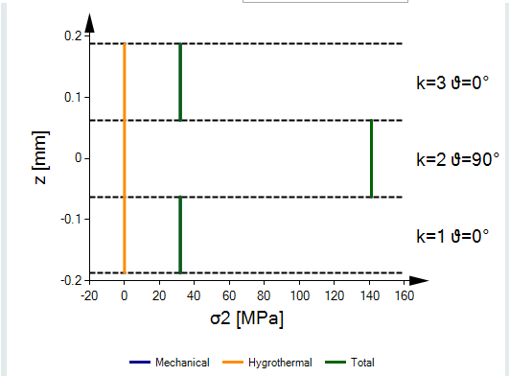
σ₂ in [0/90/0] T300/944

Slide 17
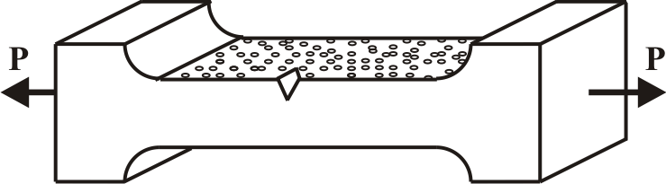
Mode I fracture toughness
Fig. 4.20
Material fails when the Energy released by the growing crack G_{I}
exceeds the energy absorbed by the material to grow a crack G_{IC}
Notes:
F2T is the transverse tensile strength of an unconstrained “thick” unidirectional lamina.

Slide 18
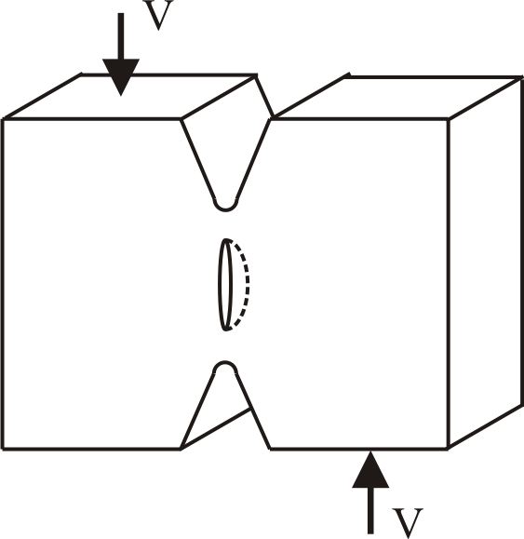
Mode II fracture toughness G_{IIC}
Fig. 4.26
Material fails when the Energy released by the growing crack G_{II}
exceeds the energy absorbed by the material to grow a crack G_{IIC}

Slide 19
In-situ strength
Transition thickness:
Glass/Epoxy : t_{t} = 0.6 mm
Carbon/Epoxy : t_{t} = 0.8 mm

Slide 20
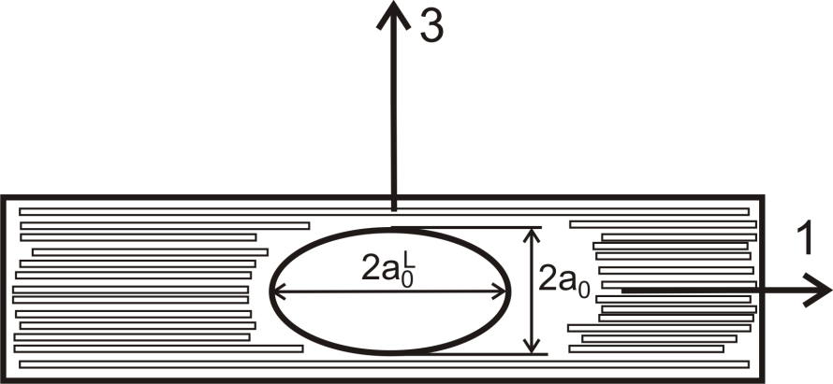
Why this happens?

Slide 21
Recap FPF
Use in-situ strength
Decide what failure criterion you want (or have-to) use
Compute FPF
If the laminate is well designed, FPF is not catastrophic, it just signals the onset of damage
To find the laminate strength, compute the last ply failure (LPF)

Slide 22
7.2. Laminate strength (LPF)
First Ply Fails
Second Ply Fails
Load
Third Ply Fails
Fracture
FF
A
B
Totally Degraded
FPF
Intact Laminate
Deformation

Slide 23
7.2.1. Ply discount
FPF: compute R@failure with the failure criteria of your choice
Degrade the moduli →
LPF: re-compute R@failure ignoring matrix modes, i.e., LPF corresponds to a fiber mode of failure (LPF is the FPF of the second round of calculations)
0<d<1: damage factor

Slide 24
Better than ply discount
Chapter 8. Damage

Slide 25
7.4. Carpet plots for strength design
Restrict the design space to the following family of laminates:
Strength-design:
Notes:
Before teaching this, I go teach 6.4 and 6.5, which I skipped when teaching chapter 6.

Slide 26
7.4. FPF tensile strength

Slide 27
7.4. LPF tensile strength

Slide 28
7.4. LPF compressive strength

Slide 29
7.4. LPF shear strength

Slide 30
Thank you !
Questions ?

