Slide 1
Introduction to CompoSite Materials Design Chapter 5: PLY mechanics
Introduction to Composite Materials Design—Third Edition
Dr. Ever J. Barbero
November 24, 2018

Slide 2
5.1. Coordinate systems
Fig. 5.1

Slide 3
5.2.1. Stress
Fig. 5.4

Slide 4
Stress: contracted notation
Stress | Contracted
σ₁₁ | σ₁
σ₂₂ | σ₂
σ₃₃ | σ₃
σ₂₃ | σ₄
σ₁₃ | σ₅
σ₁₂ | σ₆

Slide 5

5.2.2. Strain
Fig. 5.6
$$ε_{xx}=\frac{∂u}{∂x}$$

Slide 6
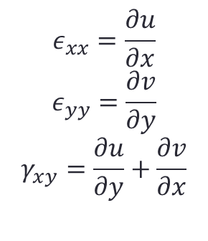
5.2.2. Strain
$$ε_{xx}=\frac{∂u}{∂x}$$
$$ε_{yy}=\frac{∂v}{∂y}$$
$$γ_{xy}=\frac{∂u}{∂y}+\frac{∂v}{∂x}$$
Fig. 5.7

Slide 7
Strain: contracted notation
Strain | Contracted
ε₁₁ | ε₁
ε₂₂ | ε₂
ε₃₃ | ε₃
2ε₂₃ | 2ε₄ = γ₄
2ε₁₃ | 2ε₅= γ₅
2ε₁₂ | 2ε₆= γ₆

Slide 8
5.3. Stress-strain equations
Fig. 5.8

Slide 9
5.4.1 Coordinate transformations
Fig. 5.9

Slide 10
5.4.2 Stress and strain transformation: why?
Fig. 5.1

Slide 11
5.4.1 Coordinate transformations
Fig. 5.9

Slide 12
Thank you !
Questions ?

