Slide 1
Introduction to Composite Materials Design Chapter 4: Micromechanics
Introduction to Composite Materials Design—Third Edition
Dr. Ever J. Barbero
November 24, 2018

Slide 2
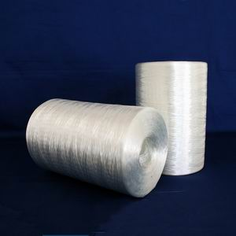
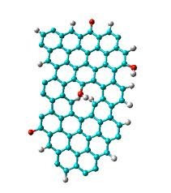
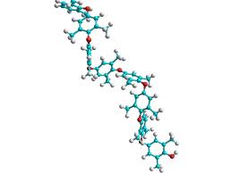
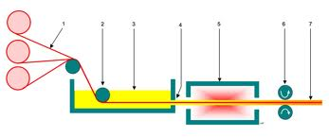
Introduction

Slide 3
Fibers
Fig. 2.2
Notes:
Pass fibers and composite for them to see how thin they are.

Slide 4
4. Micromechanics
Fig. 4.1

Slide 5
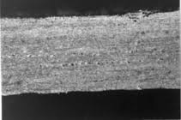
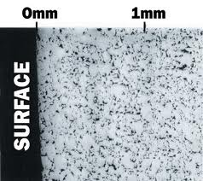
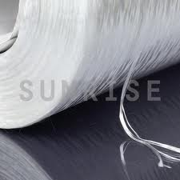
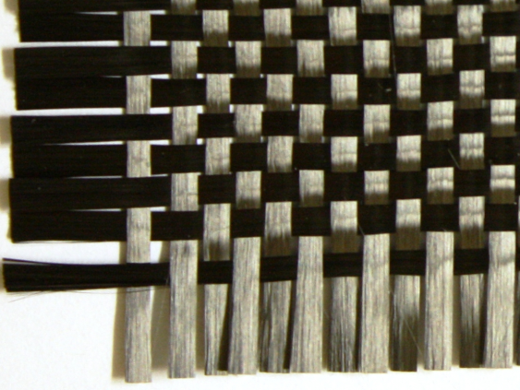
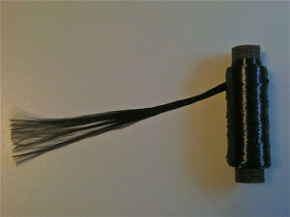
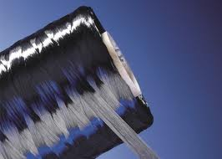
4.1.1. Volume and Mass Fractions
V_{v}=v_{v}/v_{c}
12K, IM7 carbon
w [g/m²]
TEX [g/Km]

Slide 6
4.1.2. Representative volume element (RVE)
Fig. 1.12 in Finite Element Analysis… 2007

Slide 7
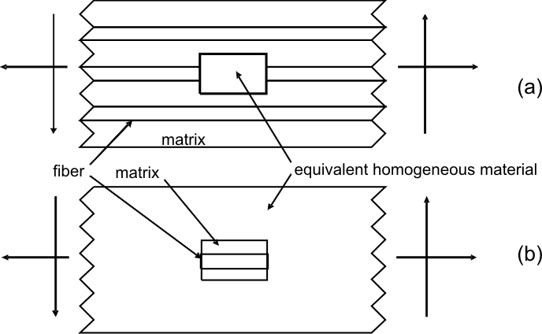
Representative Volume Element (cont’d)
Figs. 4.1.2 & 4.1.3

Slide 8
4.1.3. Heterogeneous material
Fig. 1.12 in Finite Element Analysis… 2007

Slide 9
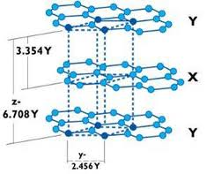
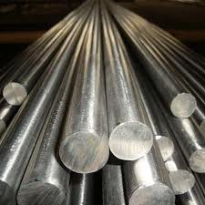
Isotropic vs. Anisotropic
Isotropic
Anisotropic
Every direction has the same properties
Every direction has different properties

Slide 10
Orthotropic material
E₁, E₂, E₃, G₁₂, G₁₃, G₂₃, ν₁₂, ν₁₃, ν₂₃
Fig. 4.4

Slide 11
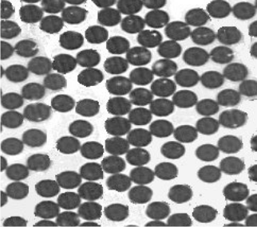
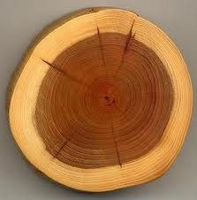
Transverse isotropy
Isotropy
Transverse isotropy

Slide 12
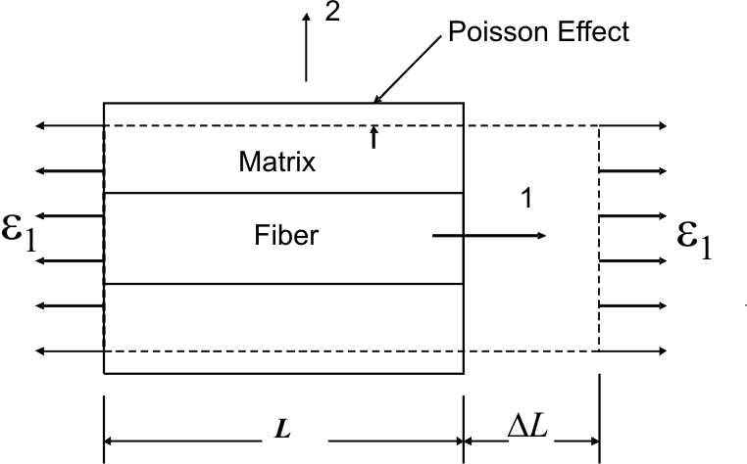
4.2.1. Longitudinal modulus E₁
Fig. 4.5
Fig. 4.3

Slide 13
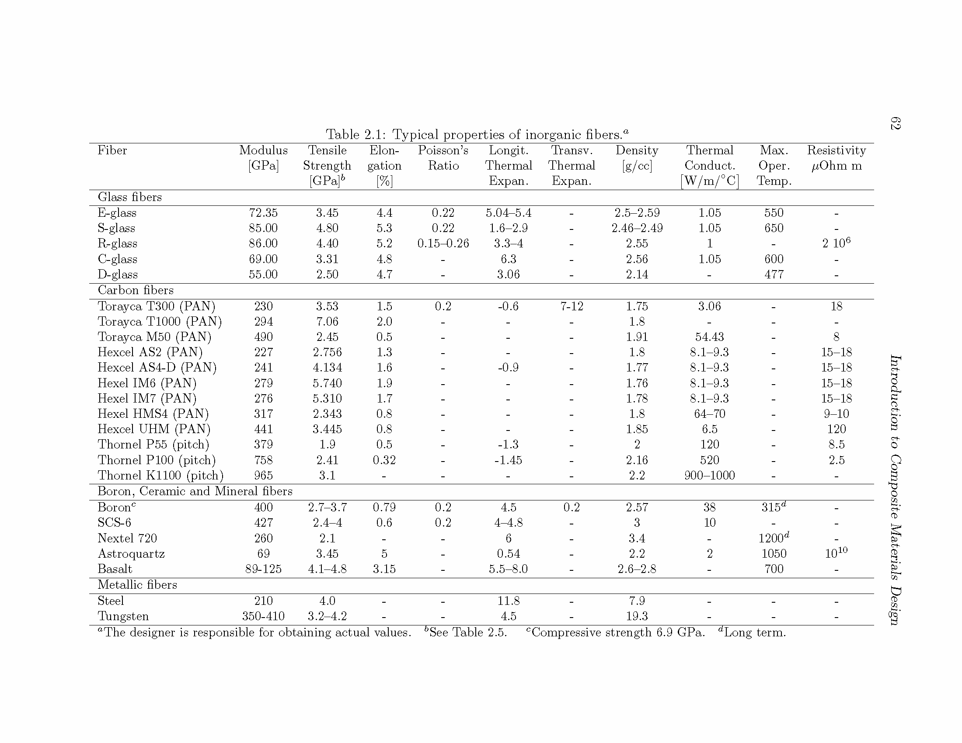
Table 2.1. Inorganic Fibers

Slide 14
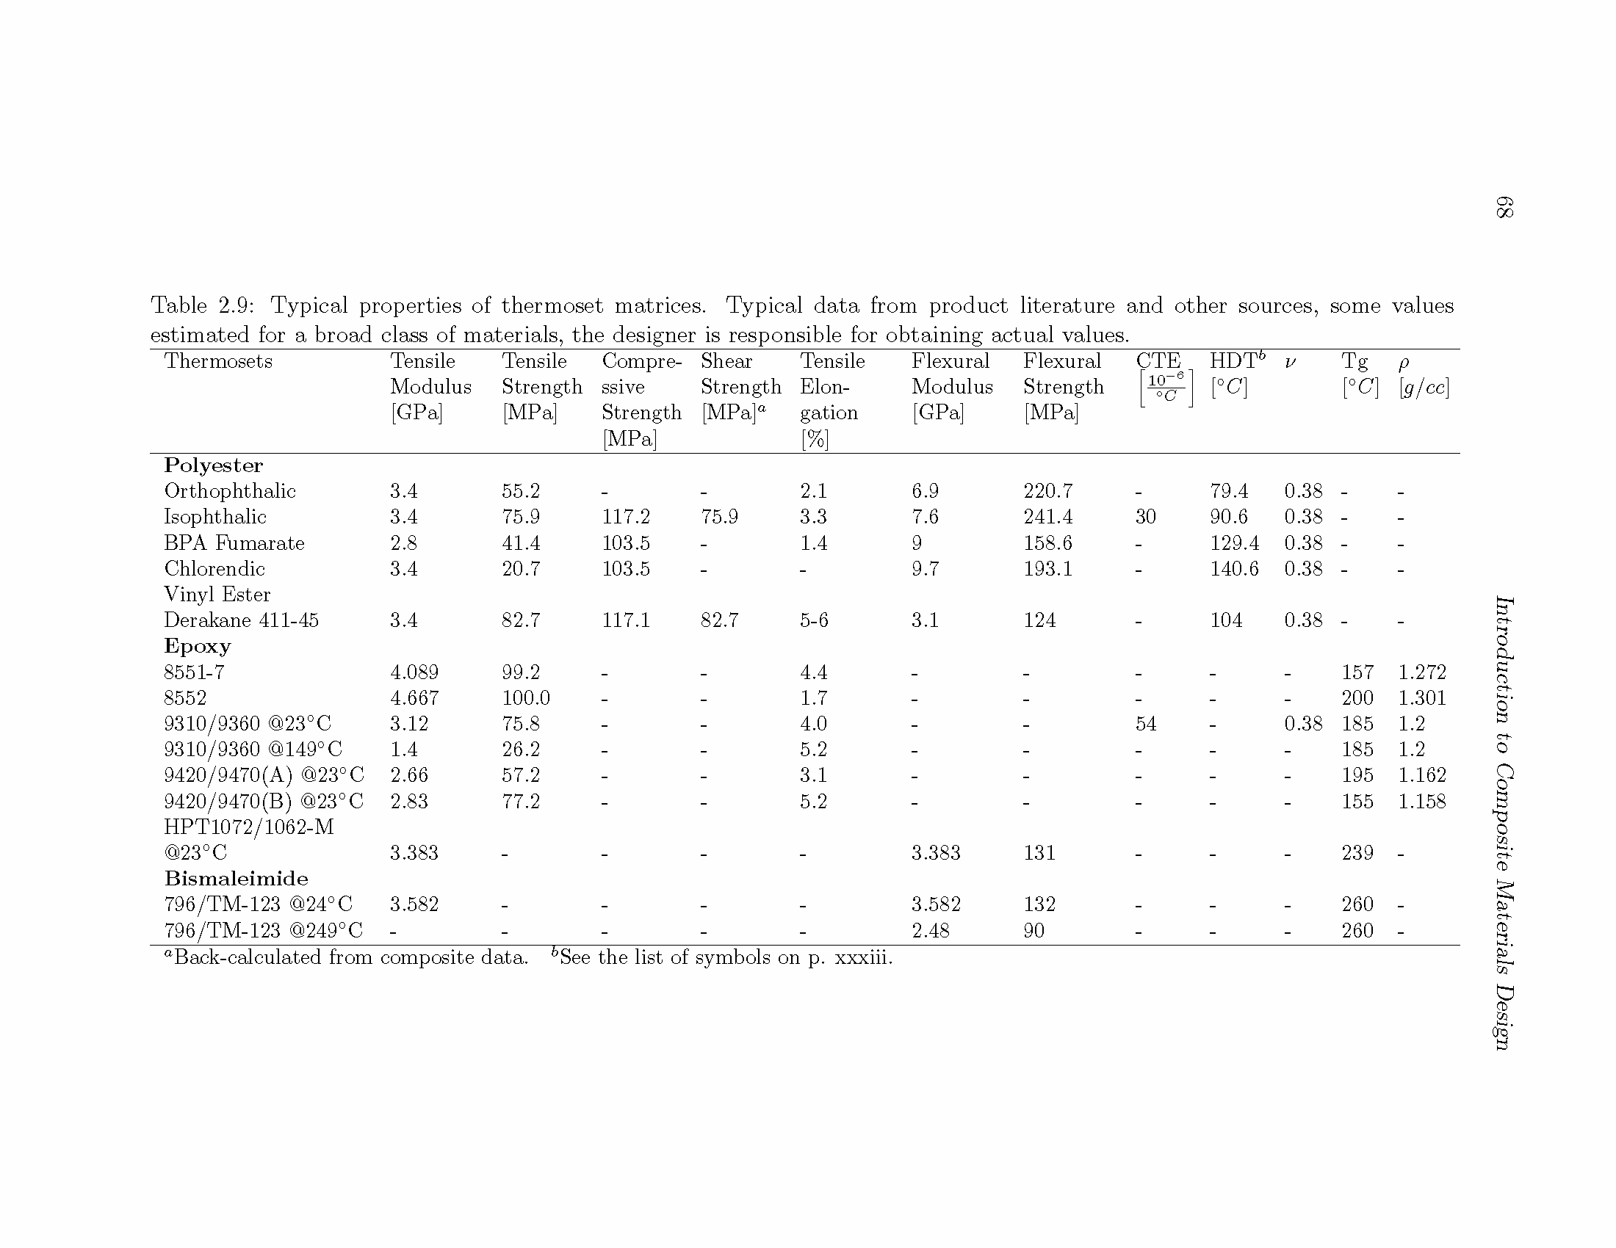
Table 2.9. Thermoset matrices

Slide 15
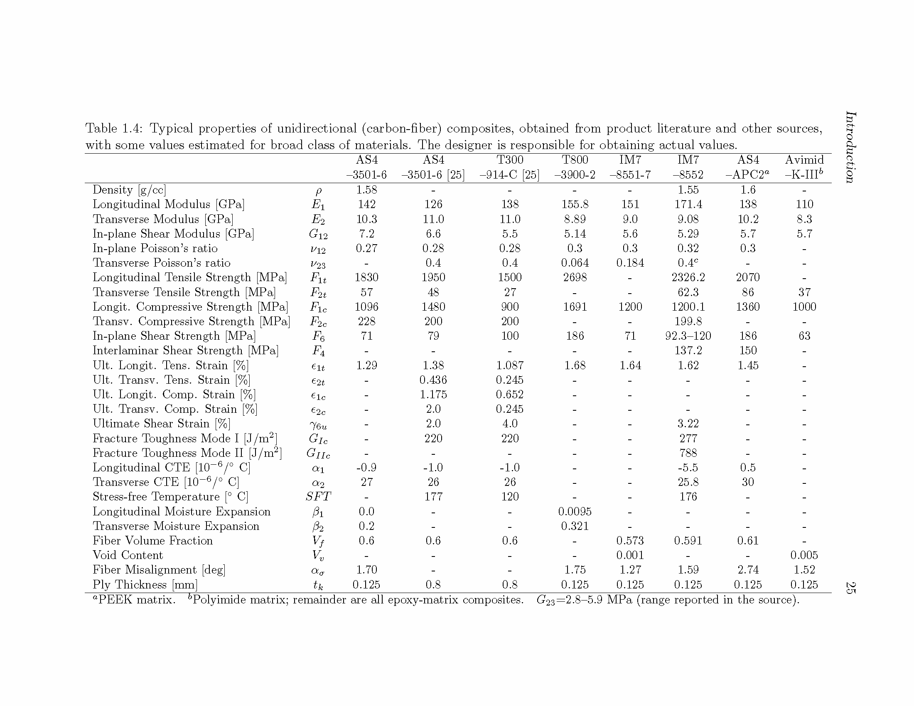
Table 1.4. Carbon fibers

Slide 16
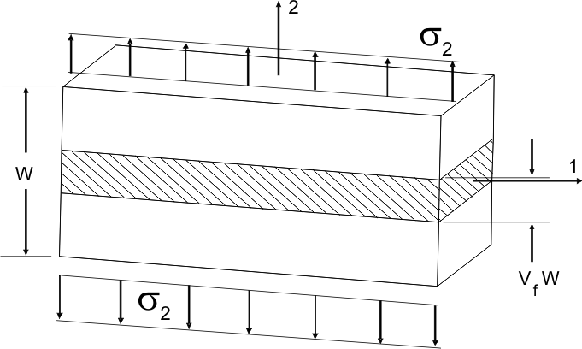
4.2.2. Transverse stiffness E₂
Fig. 4.7

Slide 17
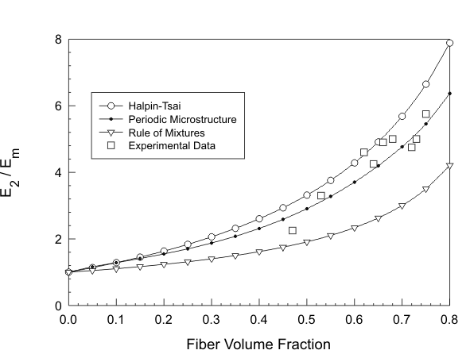
Transverse stiffness (cont’d)
Fig. 4.8

Slide 18
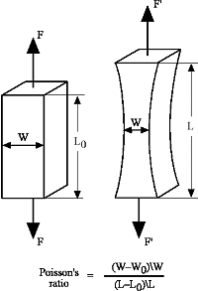
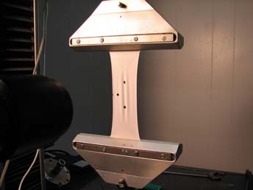
4.2.3. Inplane Poisson’s ratio ν₁₂
http://www.axelproducts.com/index.html

Slide 19
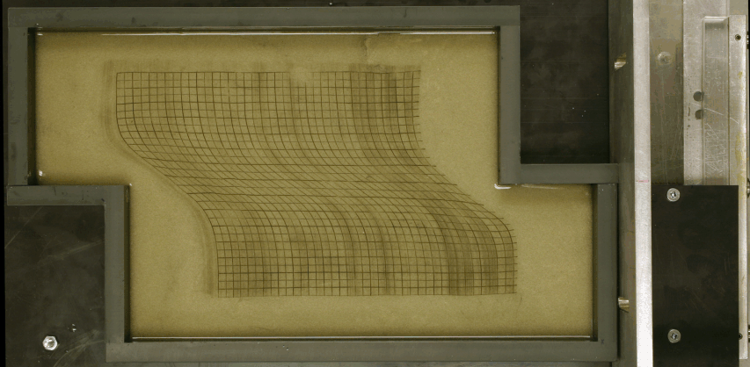
4.2.4. Inplane shear modulus G₁₂
PDMS silicone polymer. Christoph Schrank, U. of Toronto

Slide 20
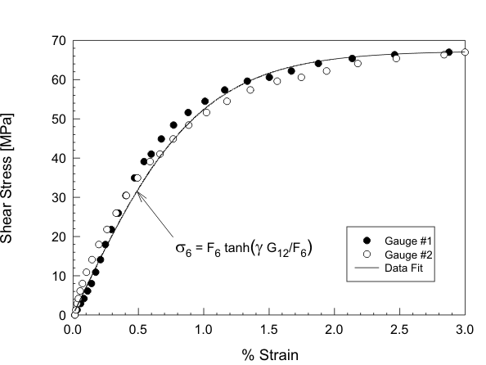
Inplane shear nonlinearity
Fig. 4.11

Slide 21
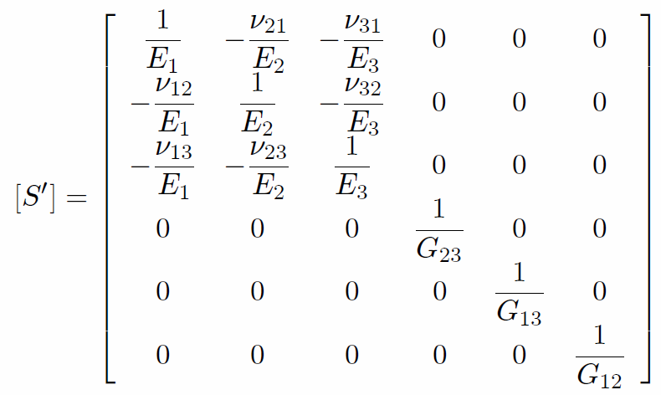
4.2.6. & 2007.1.13.1 Restrictions on elastic constants: symmetry
Notes:
Symmetry,

Slide 22
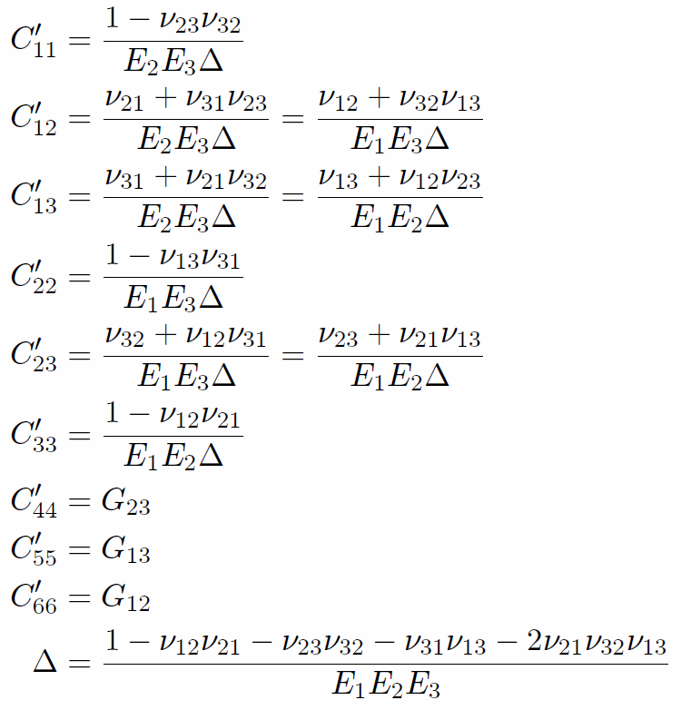
Restriction on elastic constants: diagonal > 0
>0

Slide 23
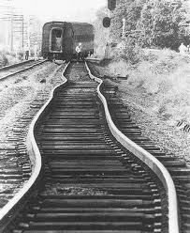
4.3.1 Thermal and moisture expansion

Slide 24
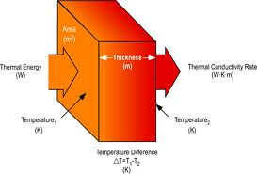
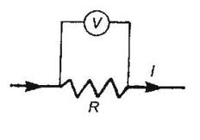
4.3.3. Transport properties

Slide 25
Strength

Slide 26
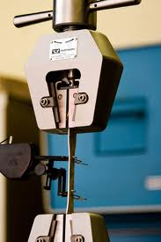
Sections 4.4.1. & 8.2. Longitudinal tensile strength F_{1t}

Slide 27
Tensile strength: classical model
Fig. 4.13

Slide 28
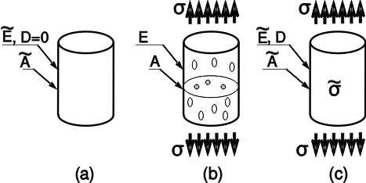
Effective stress
Fig. 8.1

Slide 29
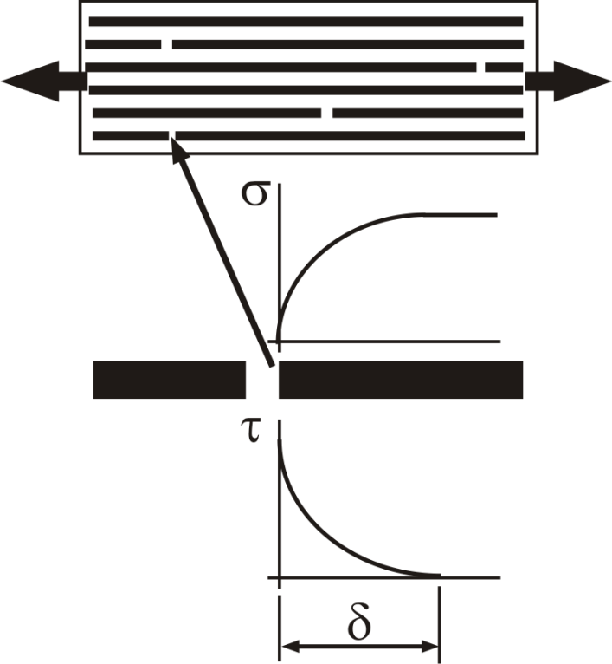
Shear lag
Fig. 8.2

Slide 30
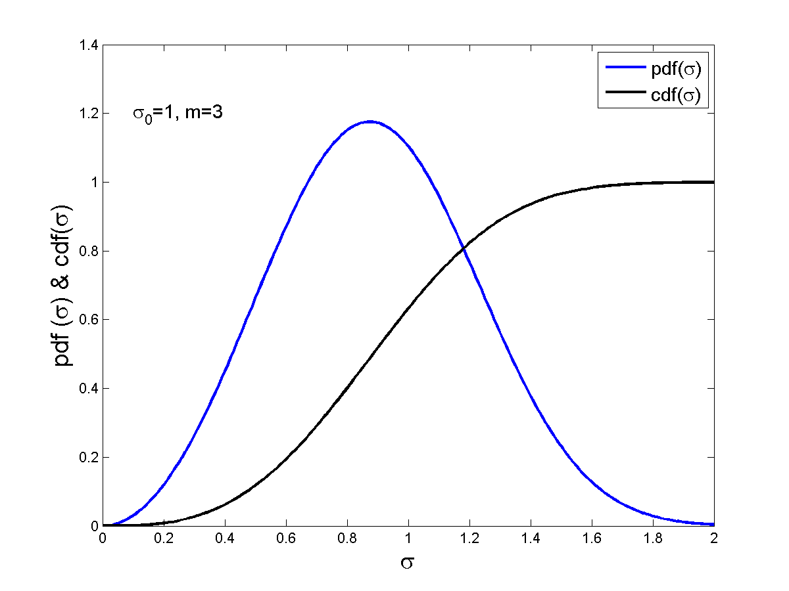
Weibull probability distribution of fiber strength
Φ(σ)

Slide 31
4.4.5. Mode I fracture toughness
Fig. 4.20
Notes:
F2T is the transverse tensile strength of an unconstrained “thick” unidirectional lamina.

Slide 32
Transition thickness
Fig. 7.8

Slide 33
4.4.9. Mode II fracture toughness G_{IIC}
Fig. 4.26

Slide 34
Where does G_{IIC} works?... Shear
Fig. 4.24
Fig. 4.25

Slide 35
4.4.2 & 4.4.3. Longitudinal compression strength F_{1c}
Fig. 4.15

Slide 36
Normal distribution of fiber misalignment
Fig. 4.17
Fig. 4.16

Slide 37
Detrimental effect of misalignment: imperfection sensitivity
Fig. 4.18
Notes:
As misalignment ->0, the max. of sigma vs. gamma tends to G12. As misalignment increases, the maximum decreases rapidly. Joining the maxima we get the imperfection sensitivity curve.

Slide 38
How this works?
:Fraction of unbuckled fibers
F_{1C}
:Strength of unbuckled fibers
:Strength of the composite
Misalignment angle
Fig. 4.19

Slide 39
MATLAB code
% plot_pdf_and_cdf
% this .m script plots the pdf, cdf, and folded Normal distribution
z = [-4:.1:4];
plot(z,pdf('normal',z,0,1),'-b','linewidth',2);hold on
xlabel('\fontsize{14}z')
%ylabel('\fontsize{14}A(\alpha)')
axis([-4 4 0 1.2])
grid()
plot(z,cdf('normal',z,0,1),'-k','linewidth',2);hold on
plot(z,cdf('normal',z,0,1)-cdf('normal',-z,0,1),'-r','linewidth',2);hold off
legend('\fontsize{14}Normal pdf: f(\alpha)','\fontsize{14}Normal cdf: F(\alpha)','\fontsize{14}Folded cdf: A(\alpha)','location','best')
title('\fontsize{14}Normal Probability Distributions')
text(2,.5,'\fontsize{14}\mu=0, \sigma=1')
saveas(gcf,'cdfplot','png')

Slide 40
Comparison to experimental data
Table 4.2
F_{1C_exp}., G₁₂, F₆, and the standard deviation of fiber misalignment α_{σ} were measured by independent labs.

Slide 41
4.4.7. Transverse compression

Slide 42
Transverse compression (cont’d)
$$F_{4}=F_{2c}\cos{α_{0}} (\sin{α_{0}+\cos{α_{0}\cot{2α_{0}}}})$$

Slide 43
Thank you !
Questions ?

