Slide 1
Introduction to Composite Materials Design
Chapter 1: introduction
Introduction to Composite Materials Design—Third Edition
Dr. Ever J. Barbero
November 24, 2018

Slide 2

COMPOSITES: try to fly without them!

Slide 3

Space

Slide 4
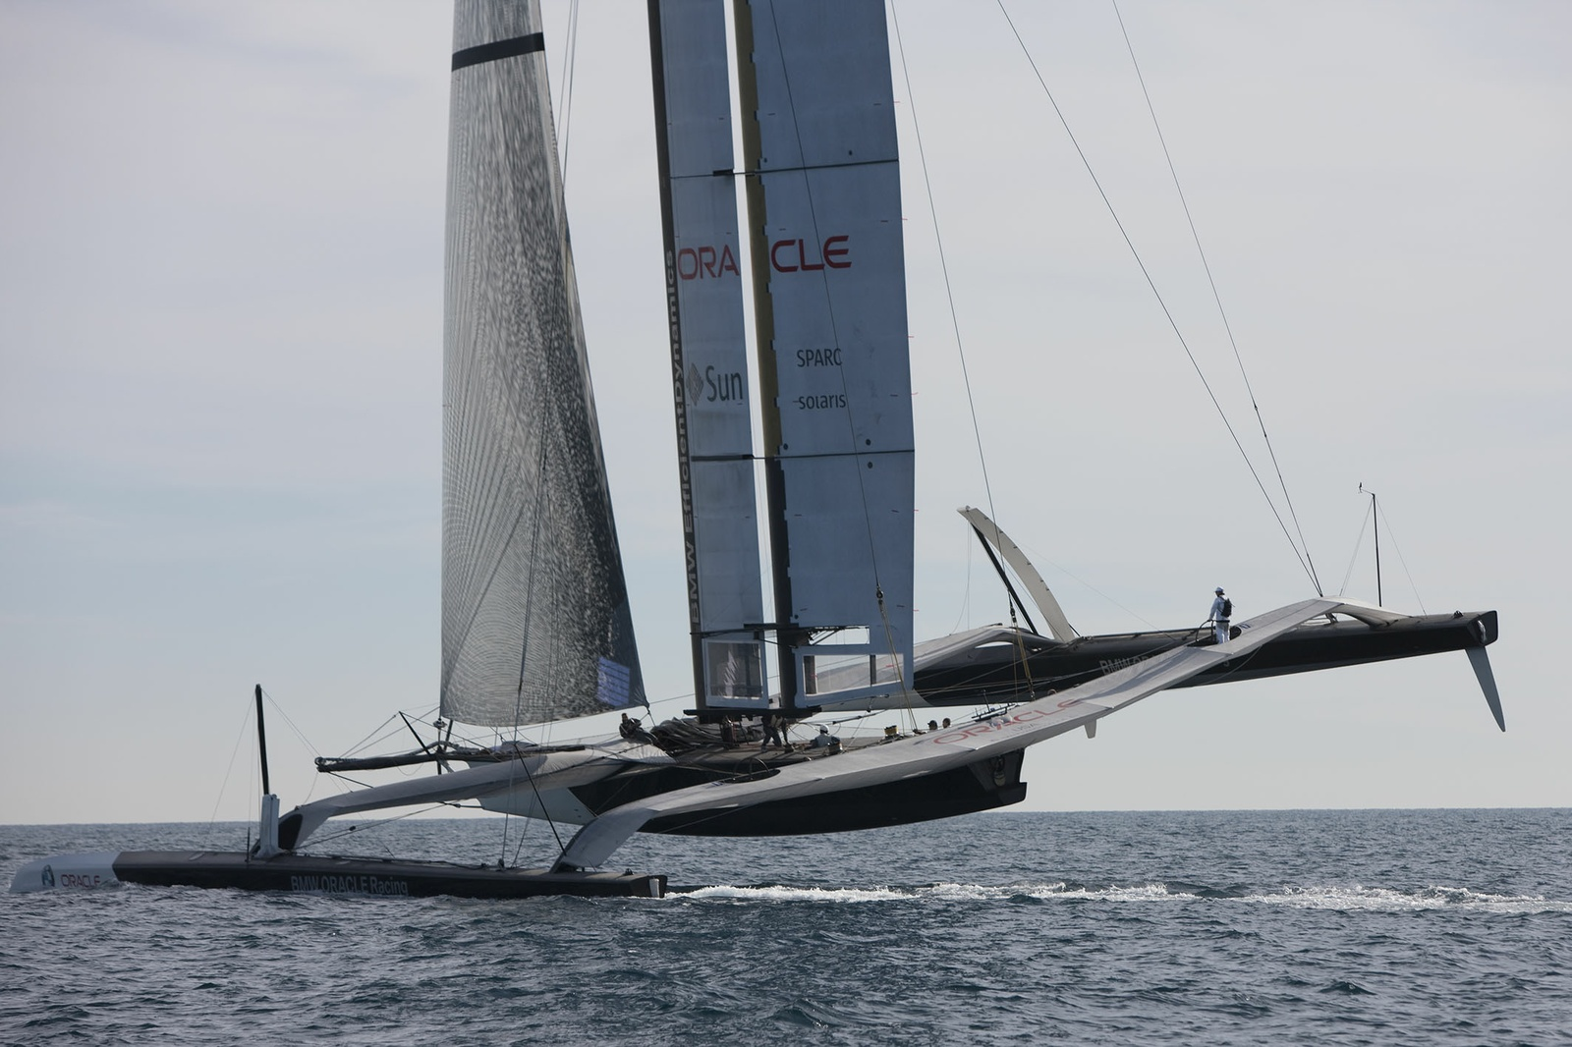
Marine
4

Slide 5

Renewable Energy
5

Slide 6

Outdoors

Slide 7

Sports Equipment
7

Slide 8

Racing
8

Slide 9
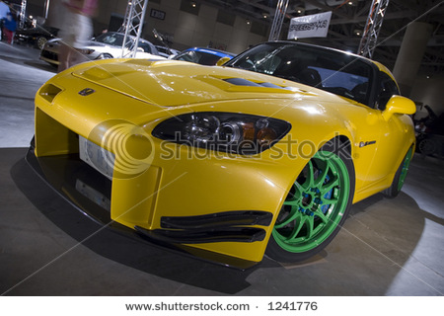
Automotive
9

Slide 10
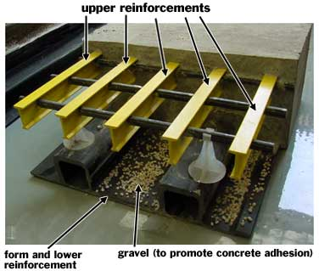
Civil Infrastructure
10

Slide 11

Biomedical
11

Slide 12
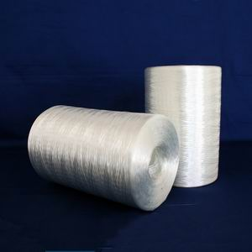
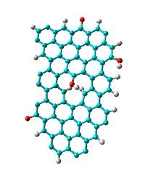
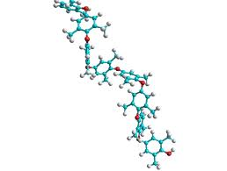
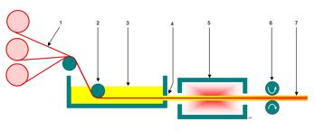
What makes this possible?
12

Slide 13
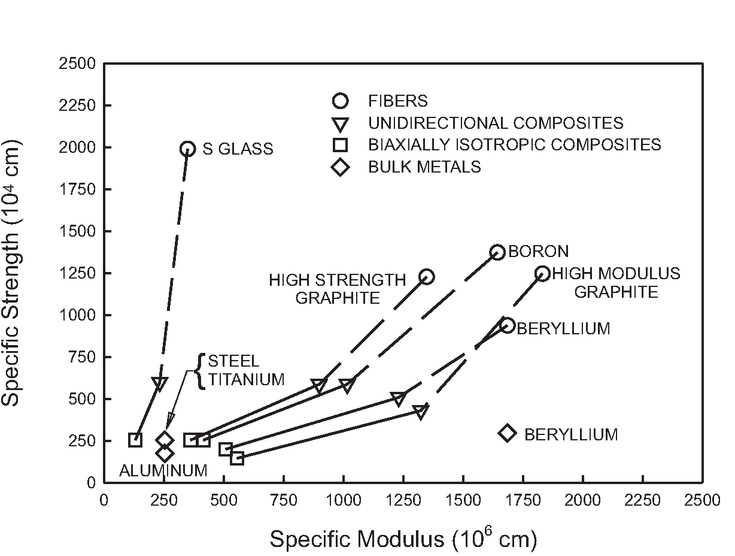
Why fibers?
13

Slide 14

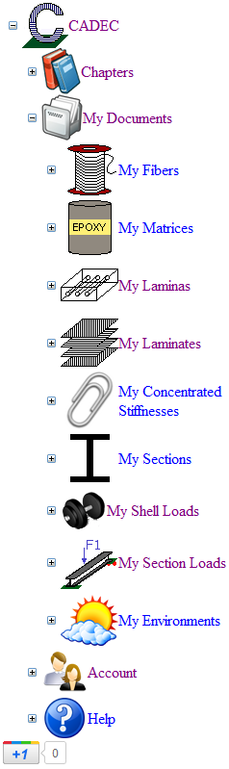



Design Strategy
14
Preliminary Design
Detailed Analysis
http://cadec-online.com/
Abaqus
LS Dyna
Genoa
Helius MCT
DDM
Notes:
Availability of commercial software means the topic is important, people are willing to pay for modeling of progressive damage. It does not mean the problem has been resolved.

Slide 15
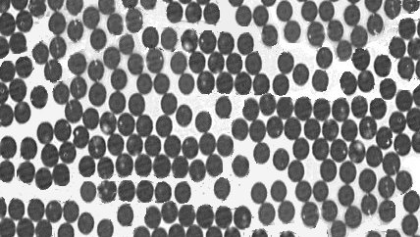
Lamina: fibers + matrix
15

Slide 16
Laminate: a collection of laminas
16

Slide 17
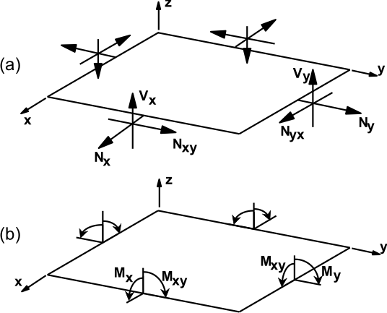
Shell Loads, Temperature & Moisture

Slide 18
Objects
Fiber
Matrix
Lamina = Fiber + Matrix
Laminate = a collection of laminas
Shell loads
  Membrane & Bending
Environment
  Temperature and Moisture change

Slide 19
Design options
Use fiber/matrix properties
  Use micromechanics (chapter 4)
  Total flexibility
  No need to test → inexpensive
  Usually requires testing of chosen lamina, for certification
Use lamina properties
  Do not use micromechanics
  More confidence in the lamina properties because they come from testing
  Less flexibility when using existing data
  Easier certification is data comes from accepted source

Slide 20
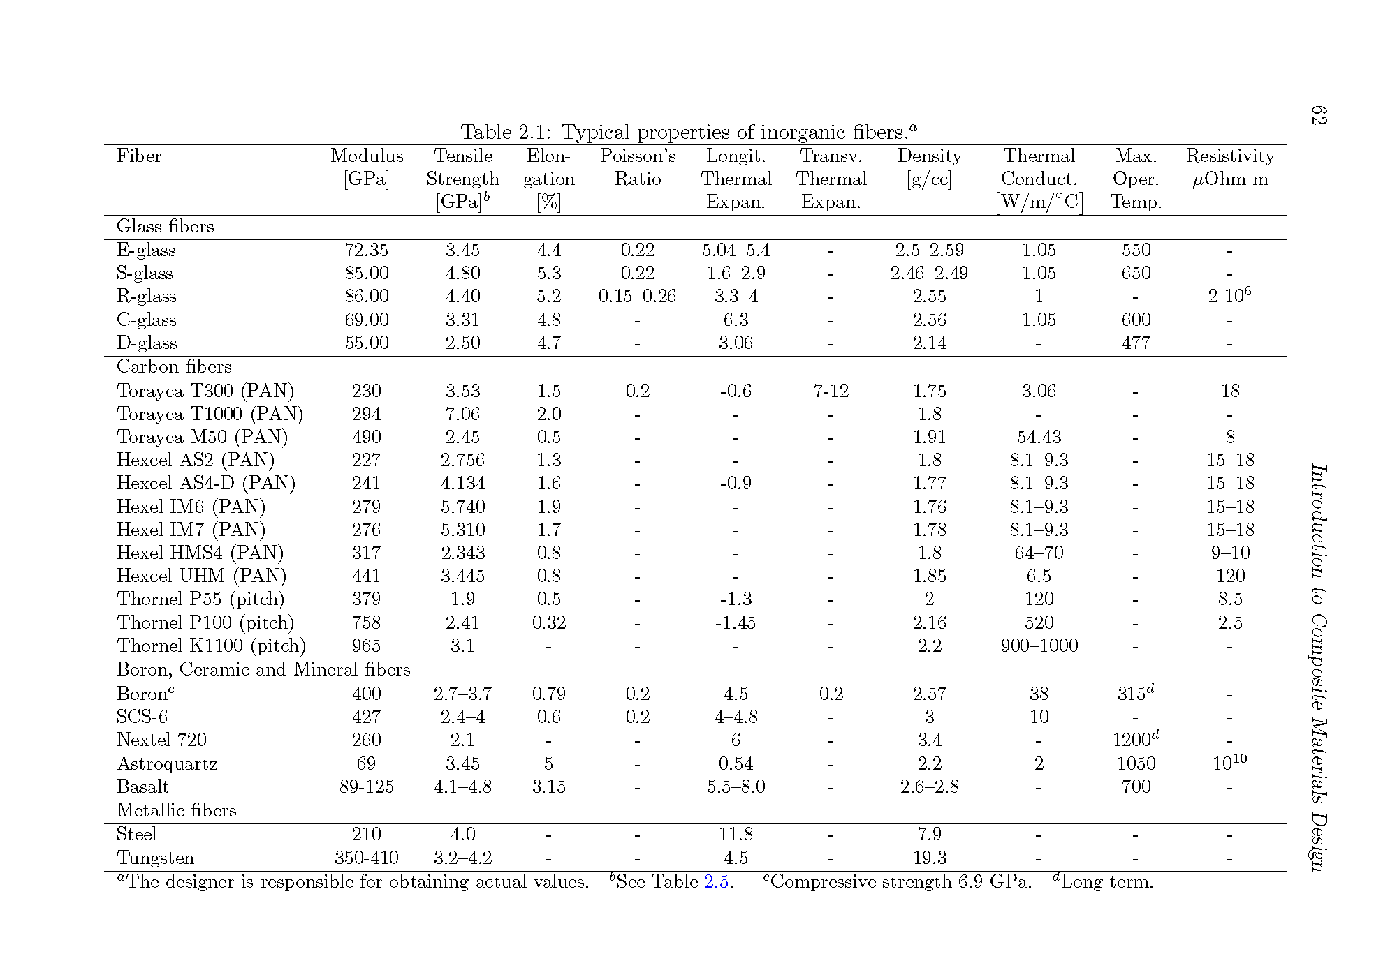
Use fiber properties (Table 2.1)

Slide 21
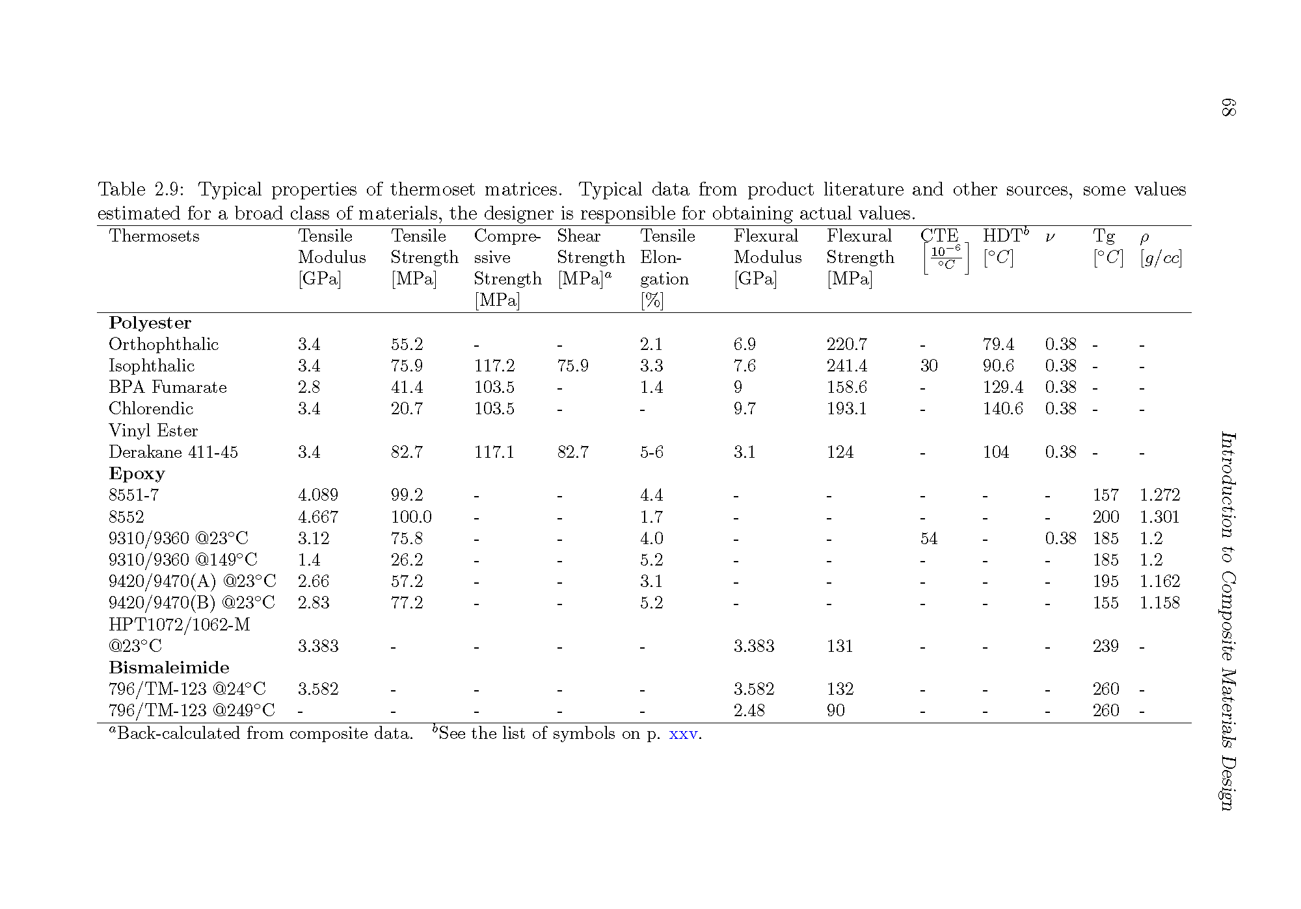
Use matrix properties (Table 2.9)

Slide 22
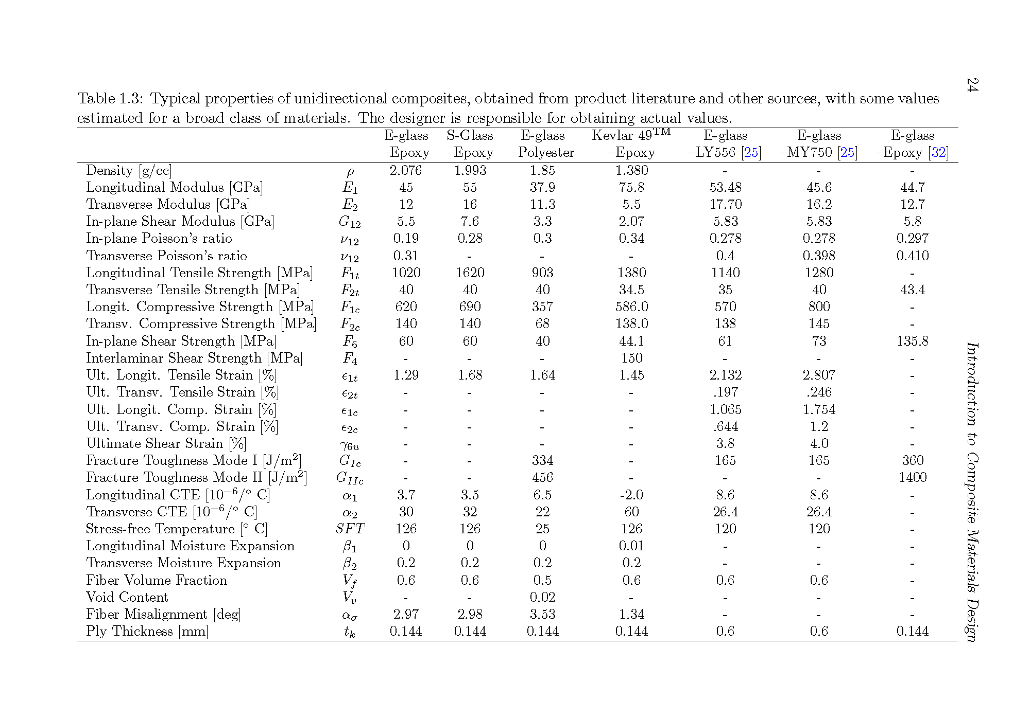
Use lamina properties (Table 1.3)

Slide 23
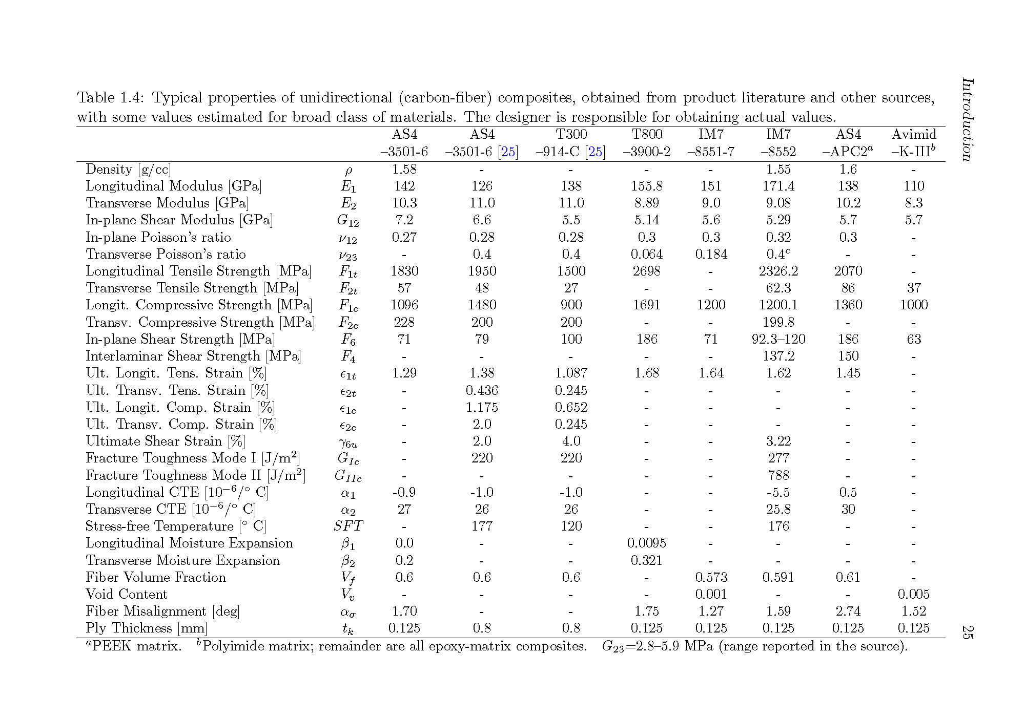
Use lamina properties (Table 1.4)

Slide 24
Design for Reliability
This page intentionally left blank to allow for the instructor verbal comments.

Slide 25
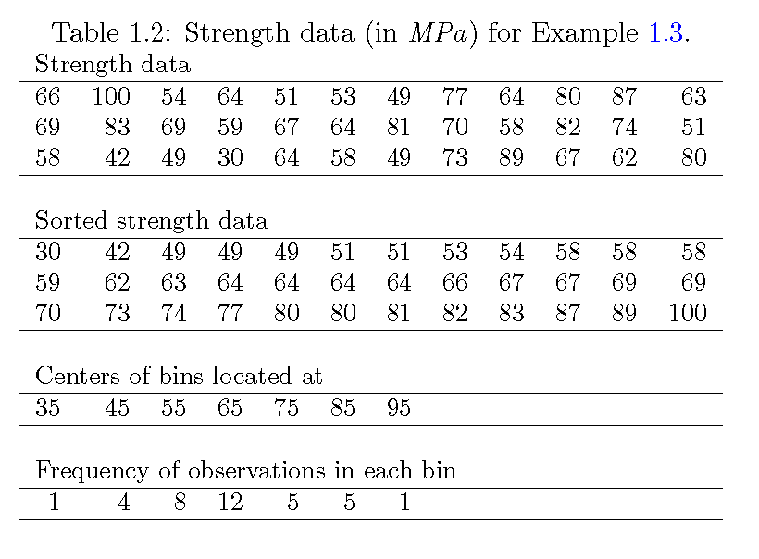
Experimental Data

Slide 26
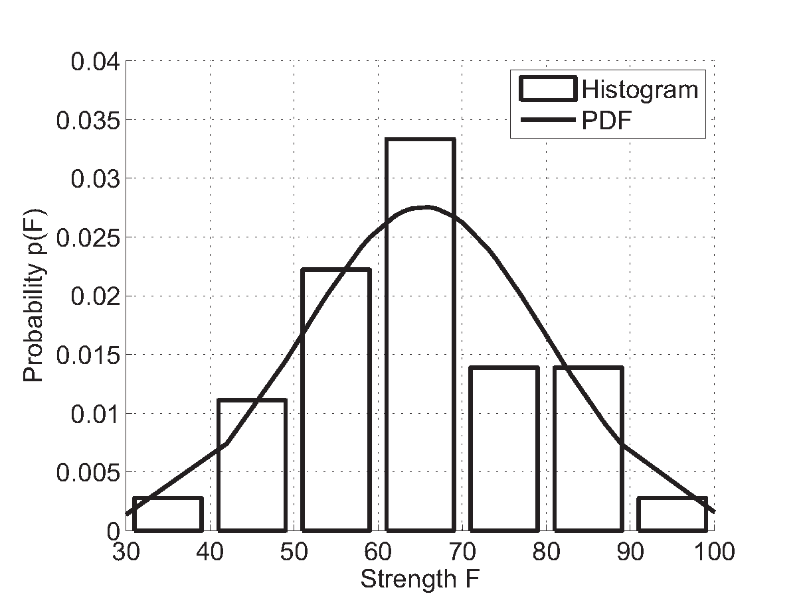
Histogram

Slide 27
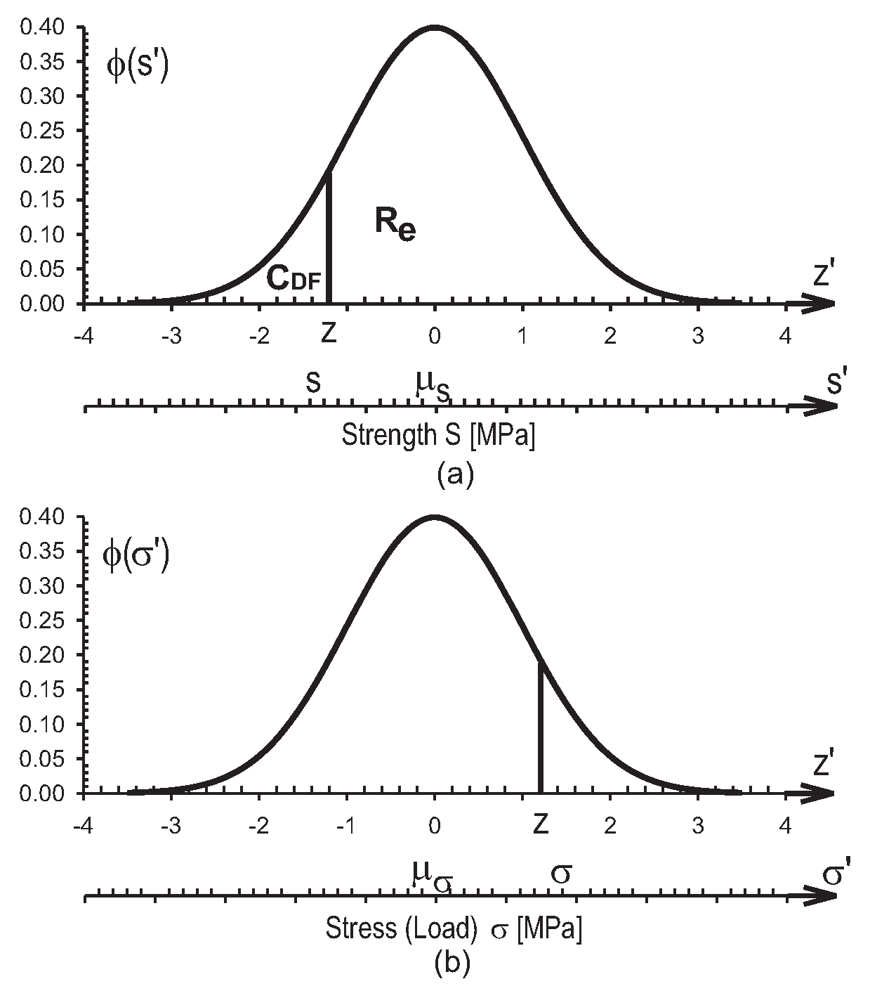
Probability Density

Slide 28
Bibliography
E. J. Barbero and J. M. Gutierrez, Determination of Basis Values from Experimental Data for Fabrics and Composites, SAMPE 2012 Conference and Exhibition, Baltimore, May 21-24, 2012.

Slide 29
Thank you !
Questions ?

